Slide 1
Studios Interop
For ATD Advanced Routing Environment
Brian Hayes

Slide 2
Overview
These slides contain examples and instructions of how to build end to end topologies with and services in Cloud Vision Studios. Featured is the Enterprise Routing Studio that is used to connect Campus and DCs together.
Arista Avanced Routing ATDs are used for these examples because they supply an easy environment for getting familiar with the interop between Studios that is required to configure complete networks.
Topologies Covered
Studios Used
Enterprise Routing
EVPN Services
L3LS
Campus
DC to DC L2EVPN
DC to DC L3EVPN + eBGP
Campus to ISP
Campus to Campus Routed
Campus to Campus L2 stretch L2EVPN
Enterprise OSPF on DC Border Leaf
VRF Lite

Slide 3
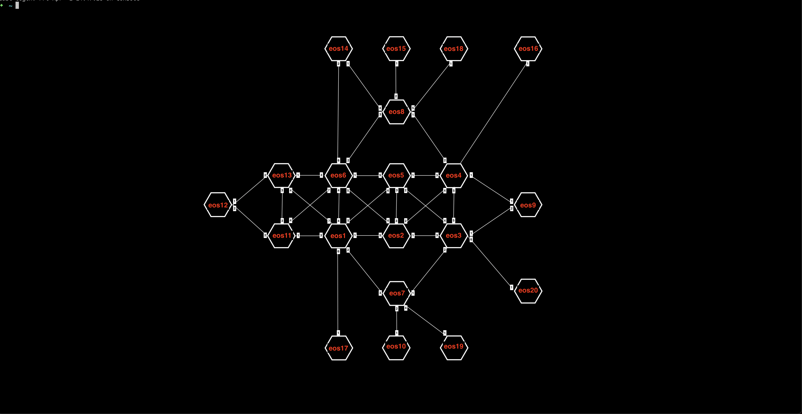
Complete Topology of the ATD
We will be using a sub-set of this topology for each Enterprise Routing Studio example

Slide 4
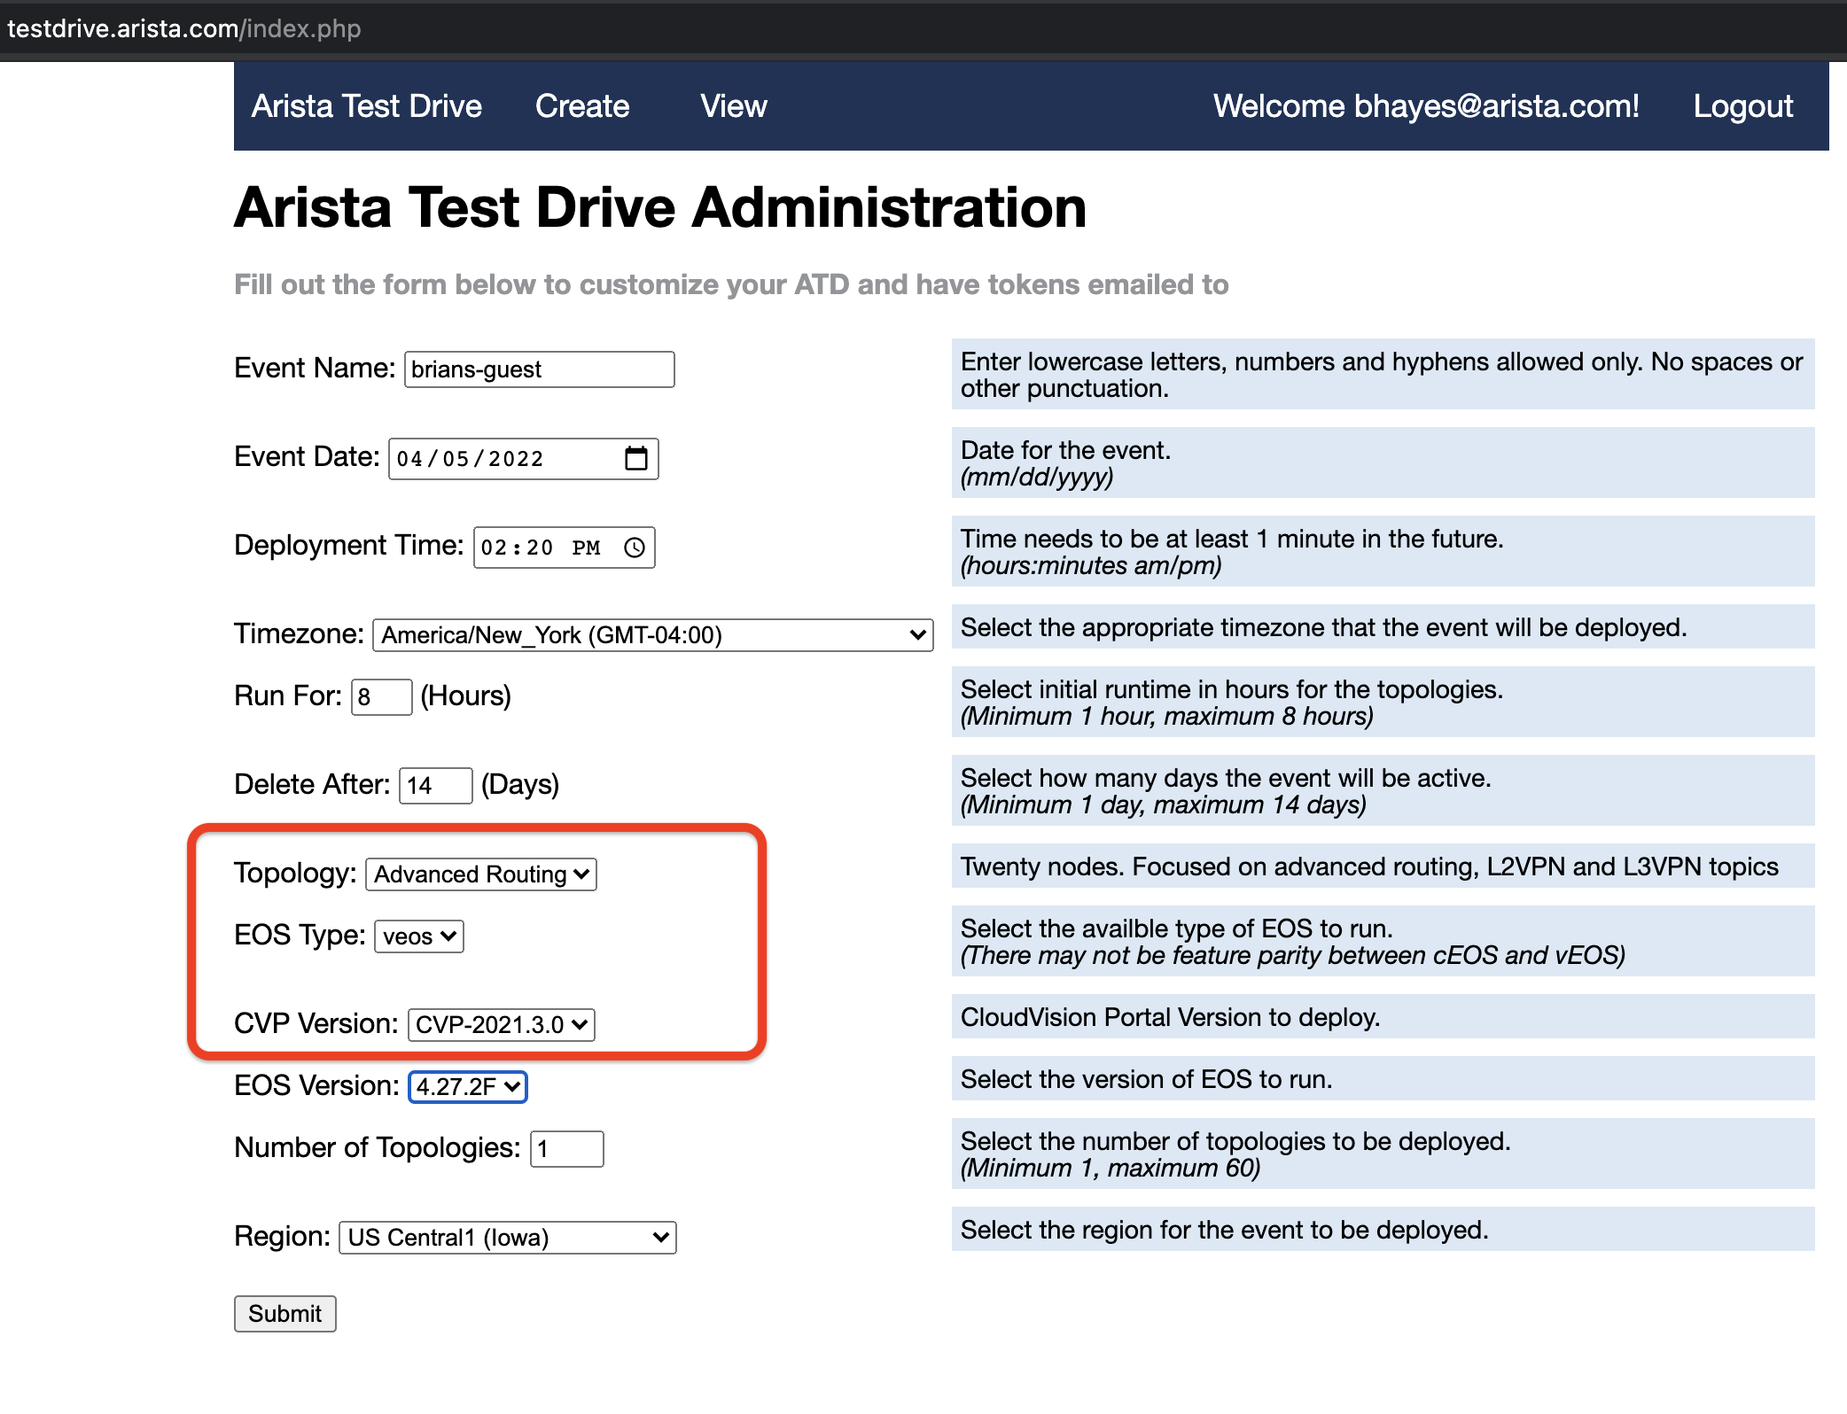
Launch the Advanced Routing ATD
https://testdrive.arista.com/

Slide 5
Files to Run the Examples
All the input data and tags have been put in files to upload into CV
Files found here:
https://github.com/arista-netdevops-community/CloudVisionPortal-Examples/tree/master/CloudVision_Studios/Enterprise%20Routing%20Studio%20Examples
Note: The interface configuration built-in studio has a bug, please use the fixed version found in the above repository
Enterprise Routing Studio is also found in this repository and must be loaded to the ATD until it is a built-in in the CV version in the ATD (Kent)

Slide 6
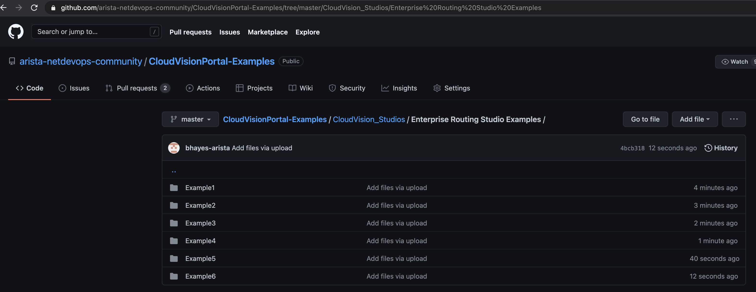
Directories with the Inputs Files for each example Down load these to your laptop

Slide 7
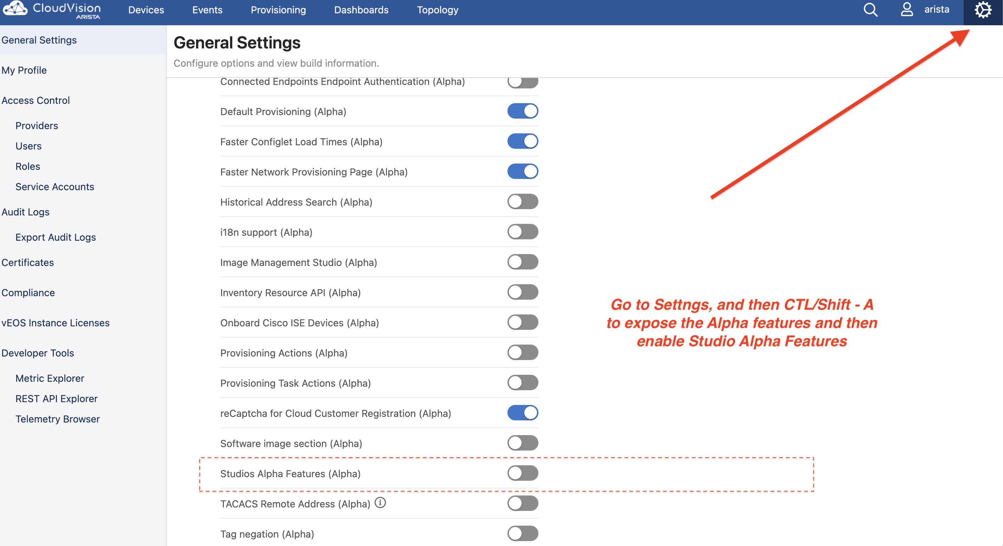
Enable Export/Import of Studios data files in CV This is an Alpha feature and needs to be enabled in the current ATD release. This allows the example files that go with these slides to be loaded.

Slide 8
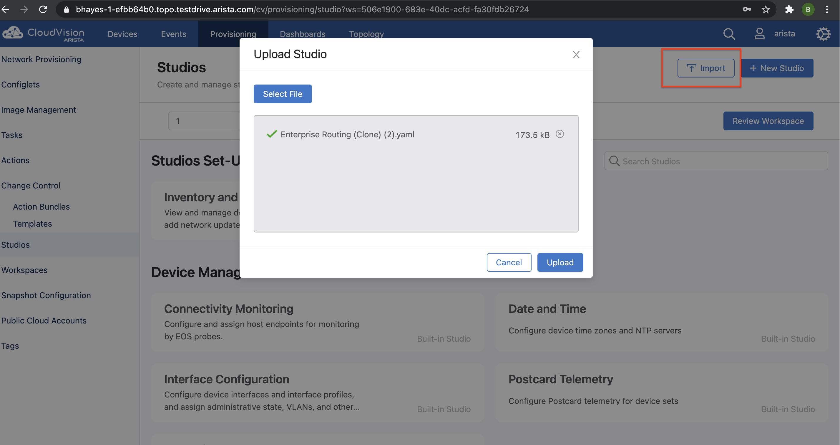
Import Enterprise Routing Studio into ATD
Once Kent version of CV is released this step is not needed because the Enterprise Routing will be a "Built-In Studio".
File location:
https://github.com/arista-netdevops-community/CloudVisionPortal-Examples/tree/master/CloudVision_Studios/Enterprise%20Routing

Slide 9
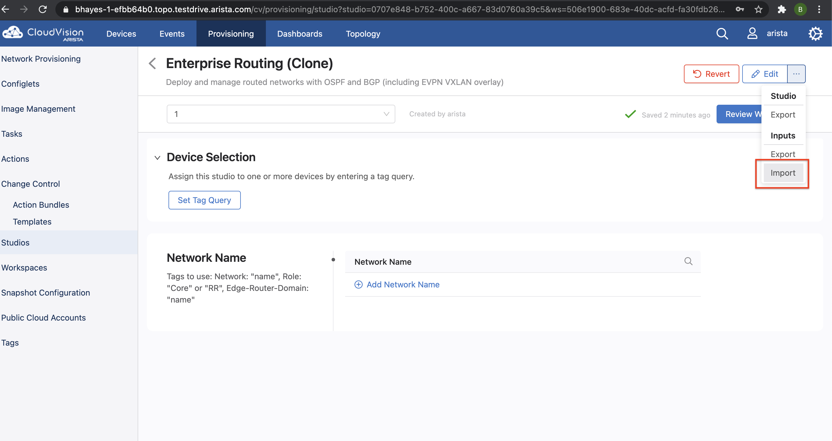
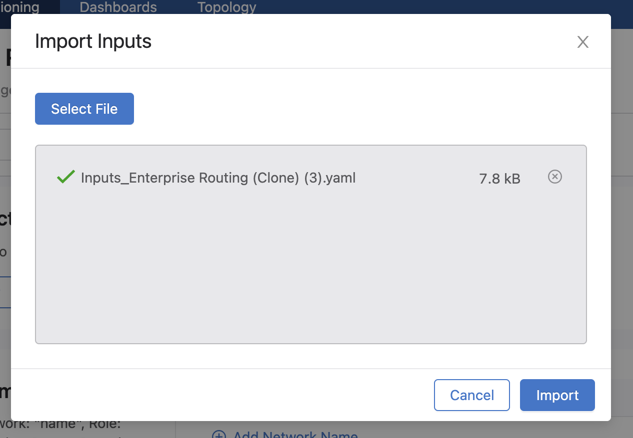
Import the Inputs for each example
All Files found here:
https://github.com/arista-netdevops-community/CloudVisionPortal-Examples/tree/master/CloudVision_Studios/Enterprise%20Routing%20Studio%20Examples
Note: The interface configuration built-in studio has a bug, please use the fixed version found in the above repository

Slide 10
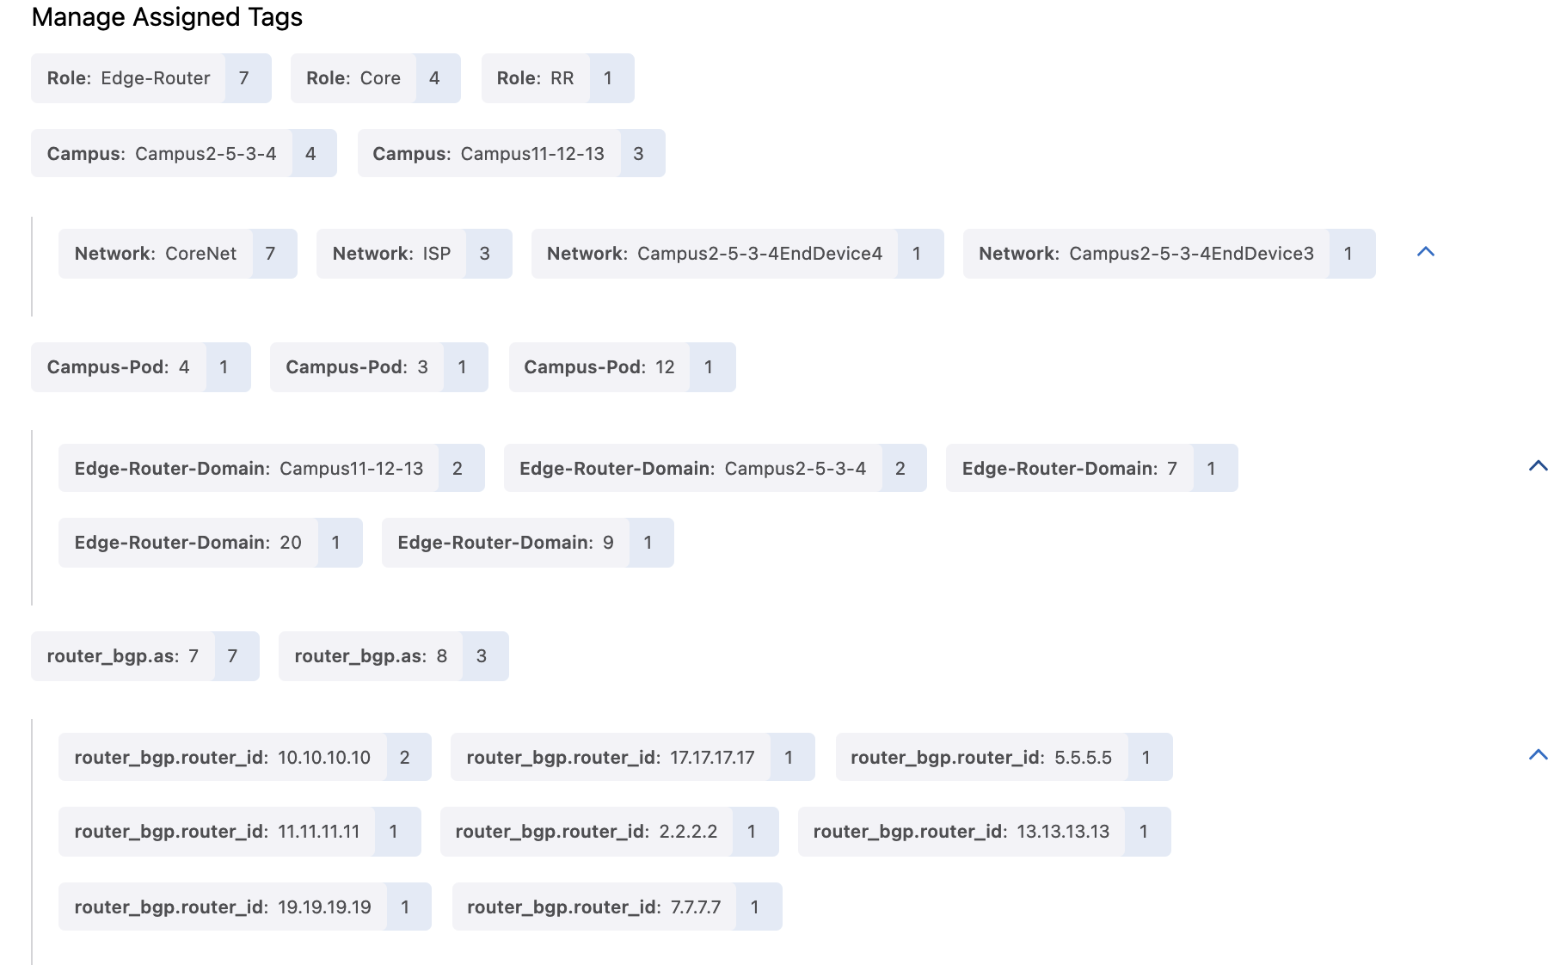
Note: Some Tags are created automatically by Studios and do not need to be entered
L3LS Studio and Enterprise Routing Studio will set ASN tags. The user does not need to create them.
L3LS Studio will set these lo0/router ID Tags. The user must create them in the Enterprise Routing Studio if using ISIS or EVPN.

Slide 11
Other Notes
Be sure to accept "updates" in the Inventory and Topology Studio prior to Selecting devices in each Studio
Be sure to check that the drop down yes/no fields in EVPN Services and Interface Studio are populated by the inputs files – Jackson release had a problem with this
When changing between examples be sure to clear the arp cache in the end devices prior to sending a ping – the mac of the gw may have changed
Use the version of Interface Studio on the github site – it fixes a bug where when changing from a routed port to bridged port is missing the "switchport" command
Use the version of the EVPN Services Studio in the github site – it has the added capability of redistributing OSPF into VRFs it creates
Both the router_bgp.as Tag and the router_bgp.router_id Tag (for lo0) are written by the L3LS Studio and do not have to be entered by the user but if Enterprise Routing Studio has EVPN/VXLAN enabled the router_bgp.router_id (lo0) tag must be added. These tags are in the tagsfile.txt
Tusing multiple role tags is only available in CV version Kent and beyond. If using Jackson do not use the Role: Edge-Router tag if L3LS is also using Role tags.

Slide 12
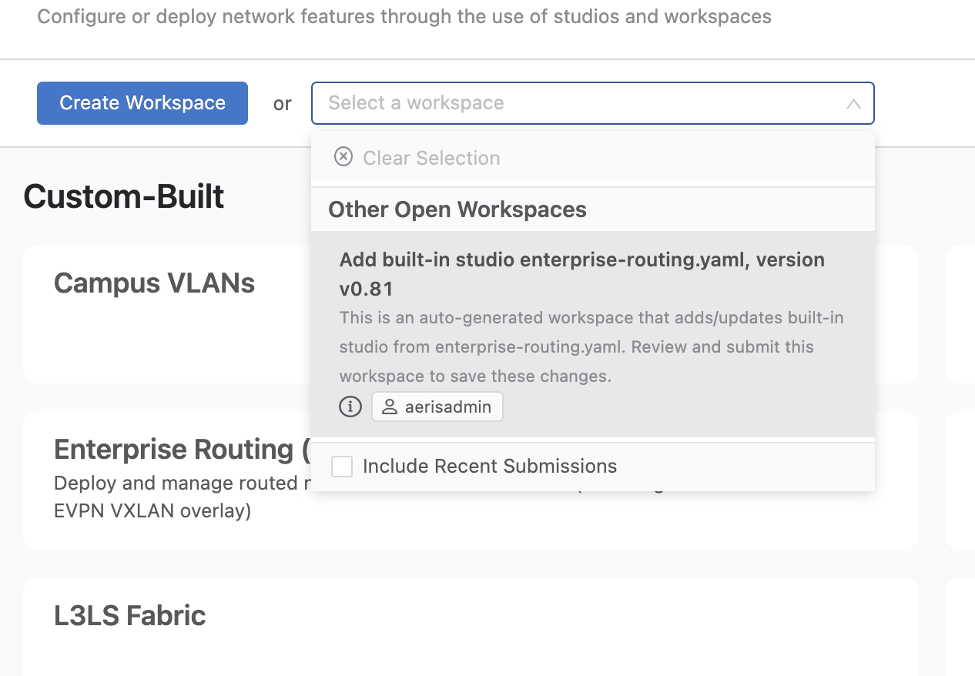
If upgrading CV, new Studios are in a workspace when the upgrade completes Submit this workspace! To add any new Studios permanently

Slide 13
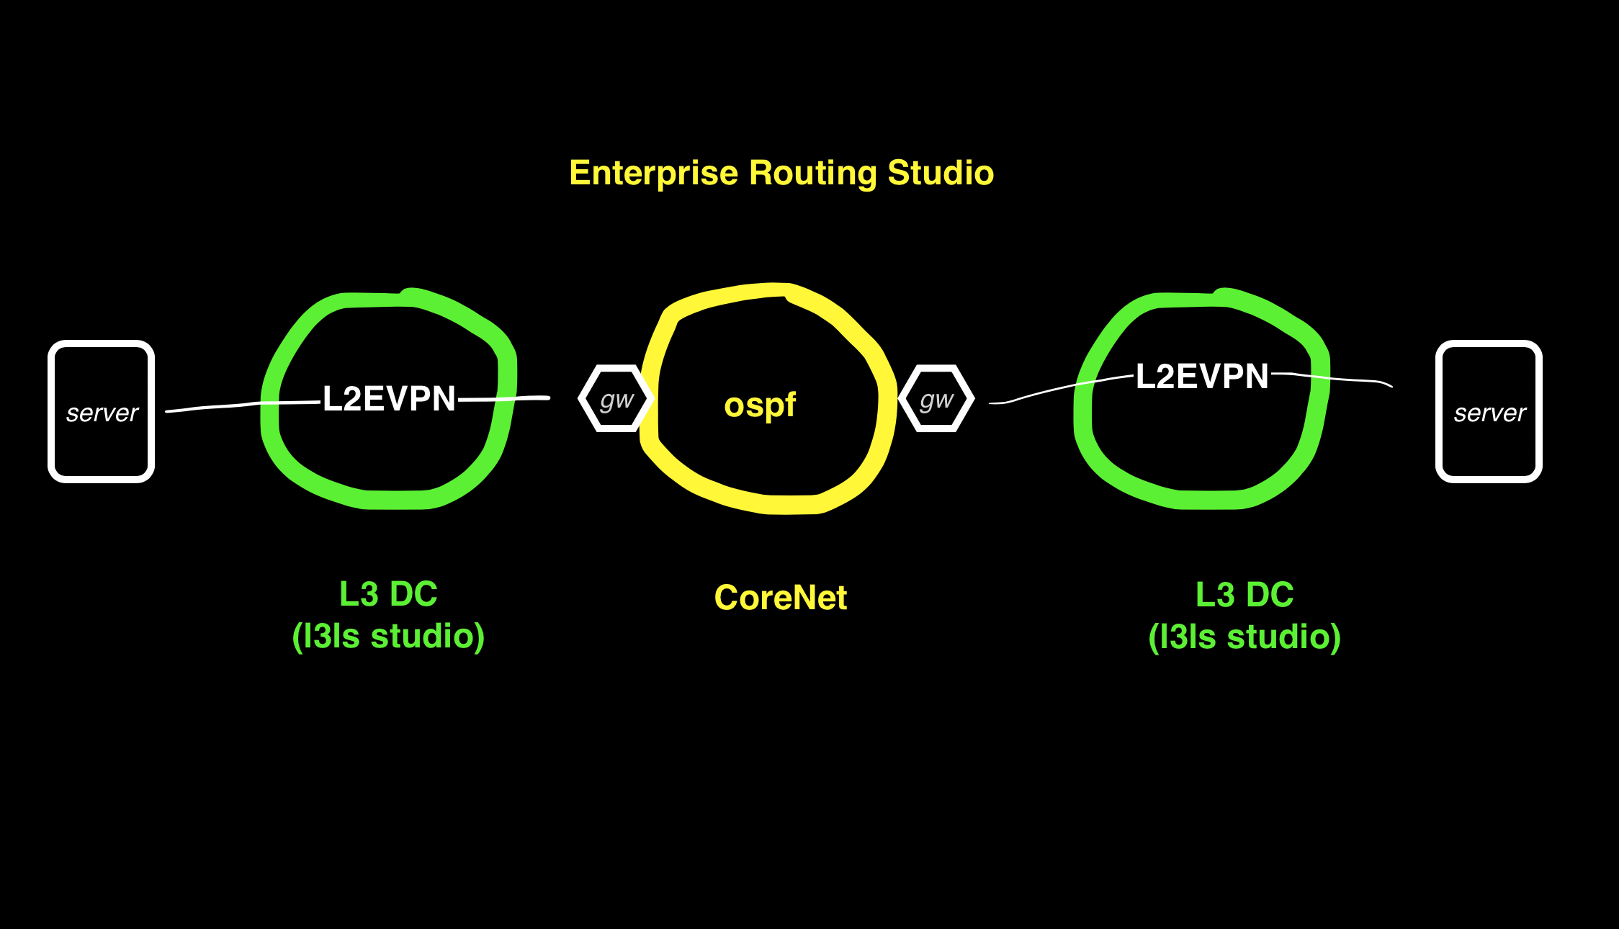
Example 1 DC Gateway Router

Slide 14
Example1: DC Gateway Router This example also routes between DCs with OSPF
In this example the Enterprise Routing Studio, consisting of a Core Router and 2 Edge Routers, connects 2 DC together
The DC border leafs have a trunk port to Edge Router and another leaf has a trunk to the end device
A vlan in 1 DC containing the end device is routed to a different vlan in another DC
Each vlan is a L2 EVPN in Each DC with the end device and the Edge Router in the VPN.
The Edge Router is the default gw for end devices in each DC. (A switch is used for the end device to launch pings from)
Example2 and example3 build on example 1

Slide 15
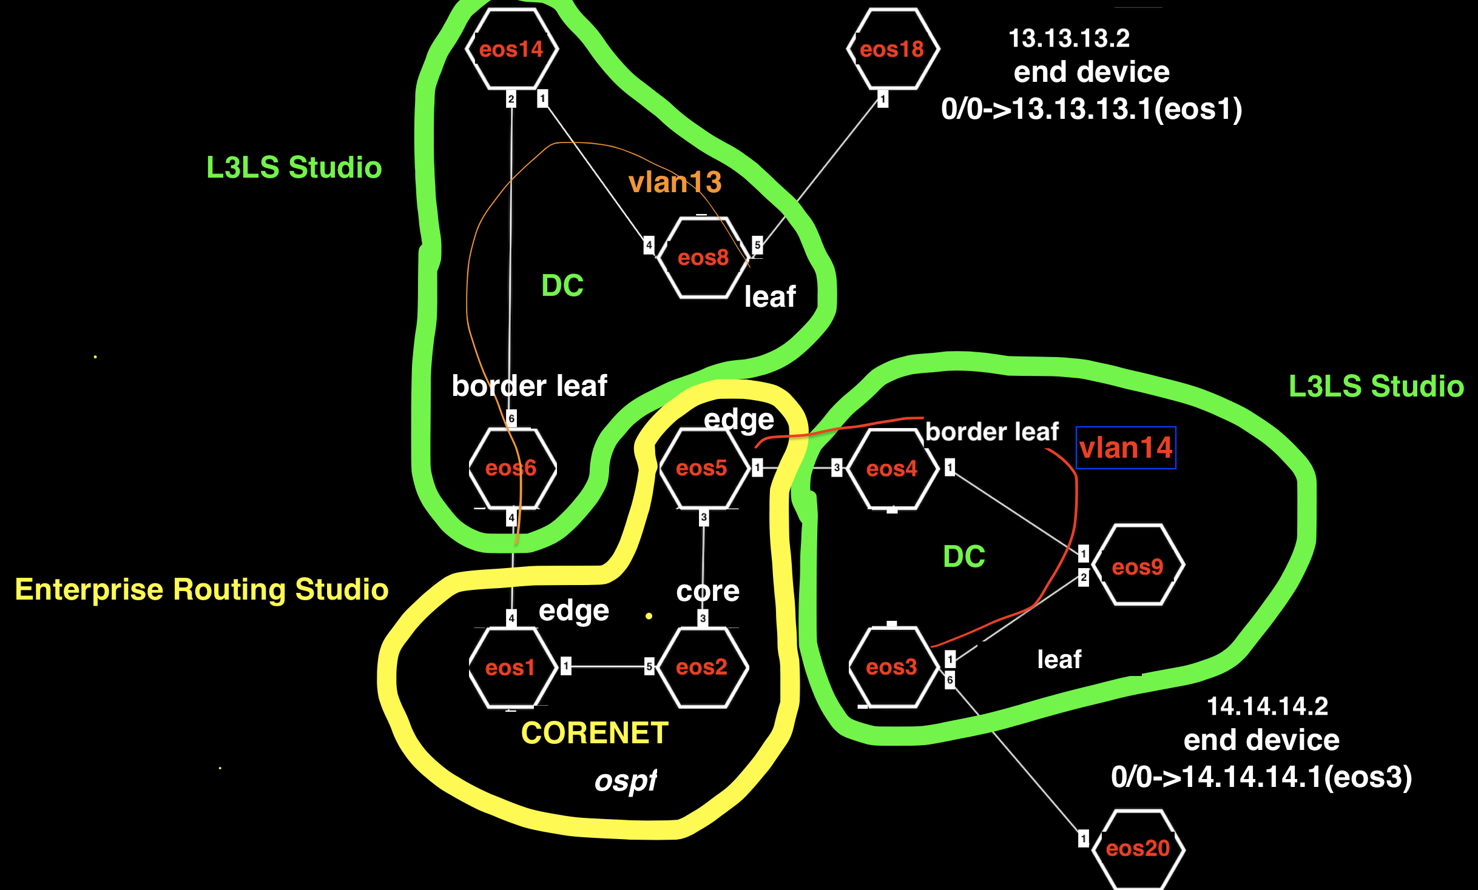
Example1

Slide 16
Example1 Tags
See tagsfile.txt to load tags through the API with tagman.py
DC-Pod:1 - EOS14
DC-Pod:1 - EOS6
DC-Pod:1 - EOS8
DC-Pod:2 - EOS3
DC-Pod:2 - EOS4
DC-Pod:2 - EOS9
DC:DC-eos3-eos4-eos9 - EOS3
DC:DC-eos3-eos4-eos9 - EOS4
DC:DC-eos3-eos4-eos9 - EOS9
DC:DC-eos6-eos8-eos14 - EOS14
DC:DC-eos6-eos8-eos14 - EOS6
DC:DC-eos6-eos8-eos14 - EOS8
Edge-Router-Domain:1 - EOS1
Edge-Router-Domain:18 - EOS18
Edge-Router-Domain:20 - EOS20
Edge-Router-Domain:5 - EOS5
Leaf-Domain:1 - EOS6
Leaf-Domain:2 - EOS8
Leaf-Domain:3 - EOS3
Leaf-Domain:4 - EOS4
Leaf-Number:1 - EOS4
Leaf-Number:1 - EOS6
Leaf-Number:2 - EOS3
Leaf-Number:2 - EOS8
Network:CoreNet-eos1-eos2-eos5 - EOS1
Network:CoreNet-eos1-eos2-eos5 - EOS2
Network:CoreNet-eos1-eos2-eos5 - EOS5
Network:DC-End-device-eos18 - EOS18
Network:DC-End-device-eos20 - EOS20
Role:Core - EOS2
Role:Edge-Router - EOS1
Role:Edge-Router - EOS5
Role:Leaf - EOS3
Role:Leaf - EOS4
Role:Leaf - EOS6
Role:Leaf - EOS8
Role:Spine - EOS14
Role:Spine - EOS9
Spine-Number:1 - EOS14
Spine-Number:1 - EOS9
router_bgp.router_id:1.1.1.1 - EOS1
router_bgp.router_id:2.2.2.2 - EOS2
router_bgp.router_id:5.5.5.5 - EOS5

Slide 17
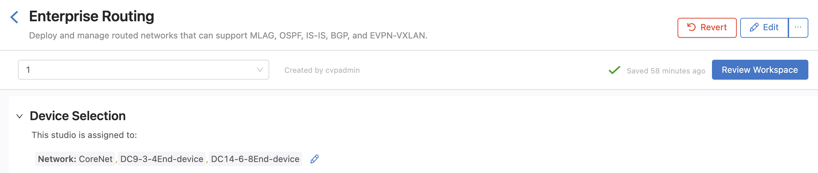
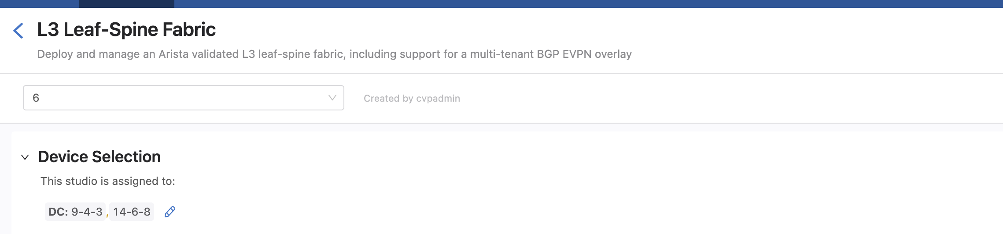
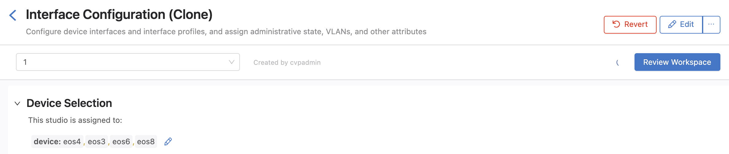
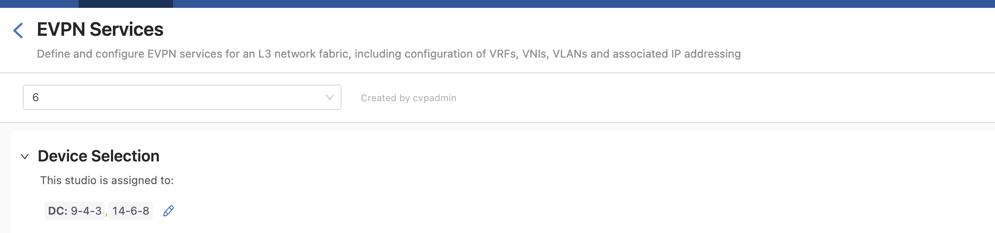
Device Selection

Slide 18
Test
From eos18 ping eos20 14.14.14.2

Slide 19
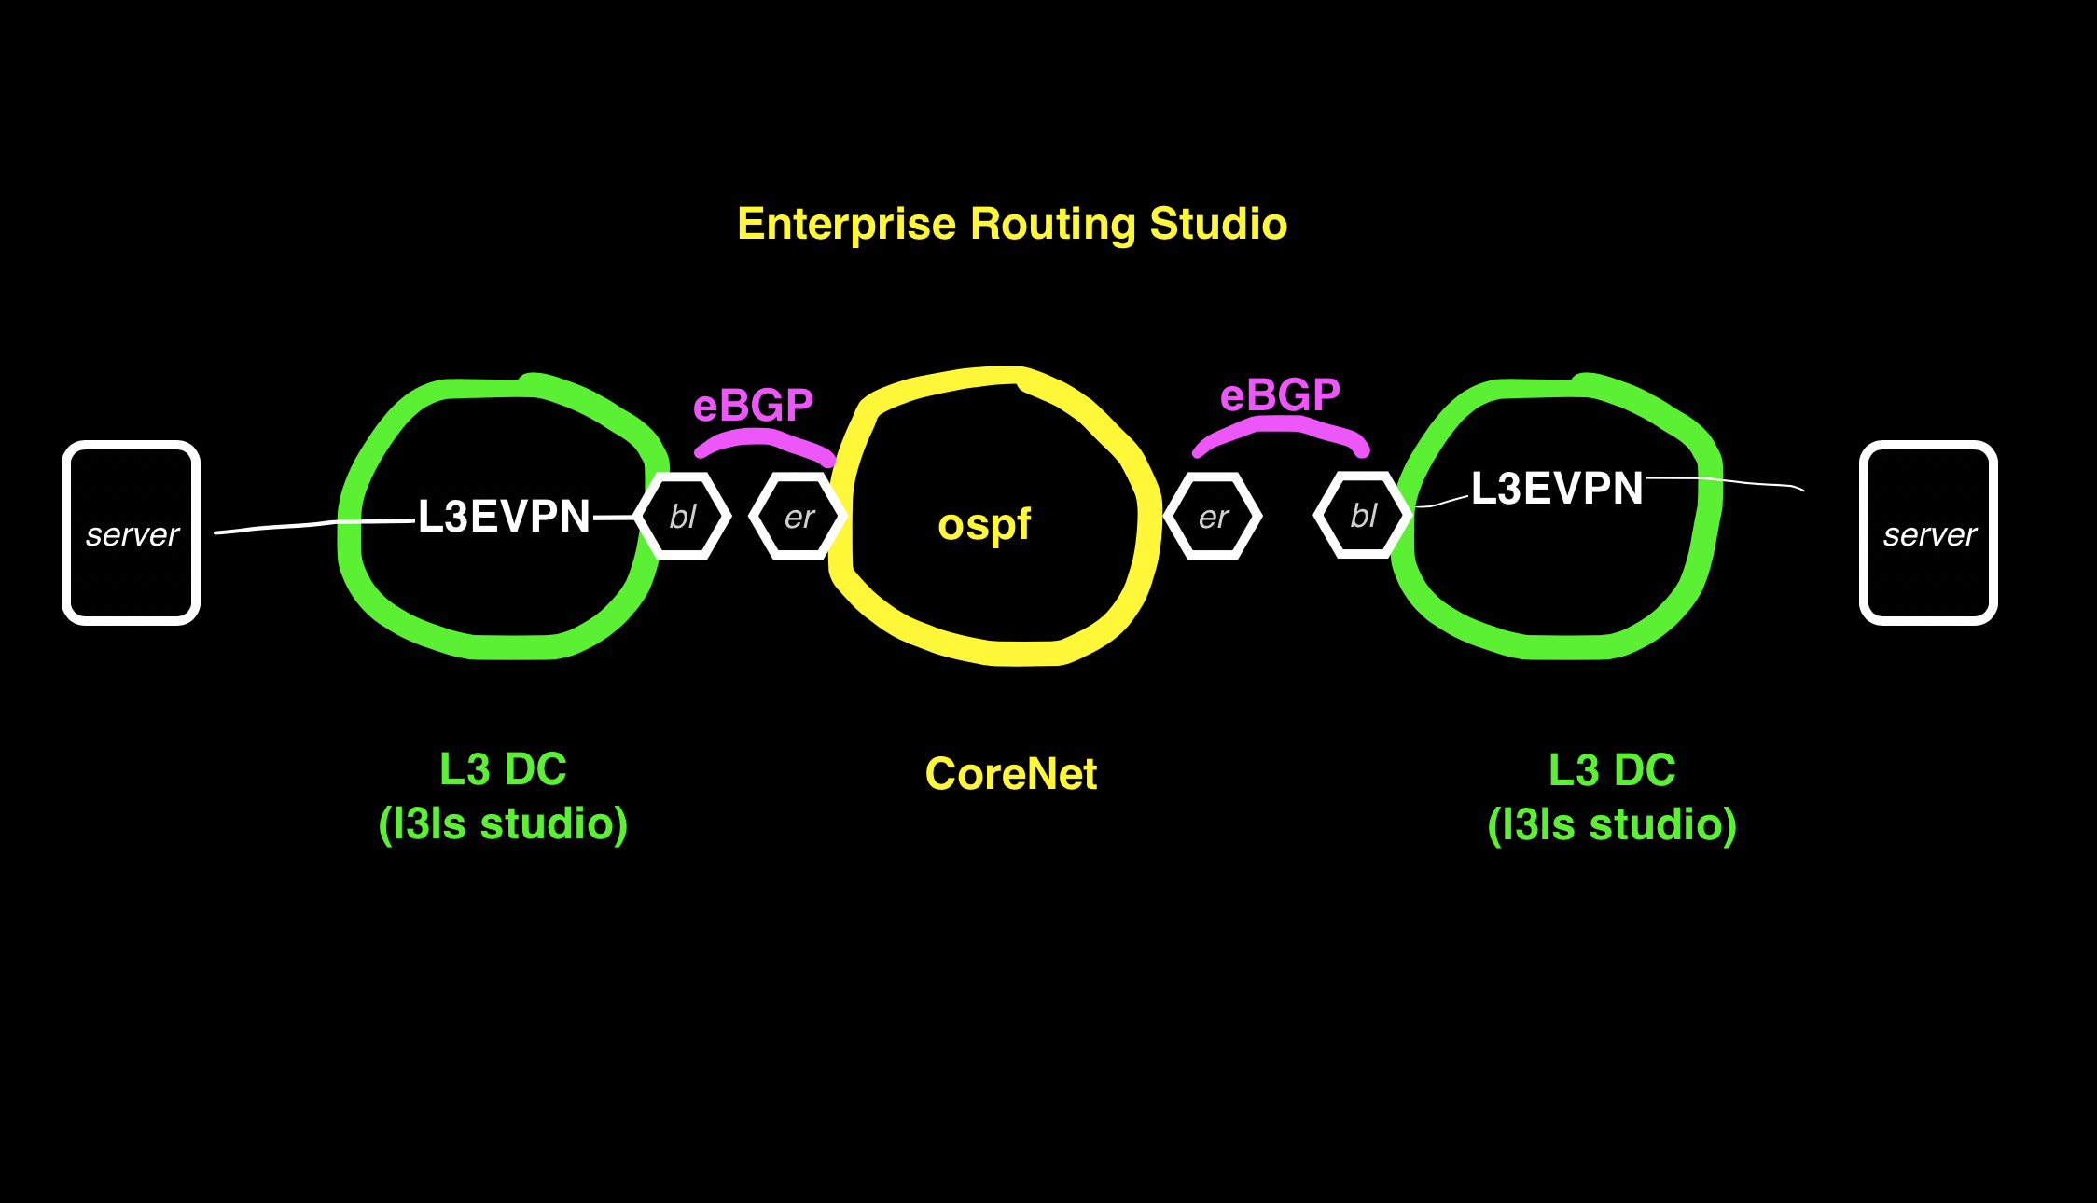
Example 2 eBGP between DC and Routed Network

Slide 20
Example2: eBGP between DC and Routed Network DCs route to each other in this example
In this example the Enterprise Routing Studio, consisting of a Core Router and 2 Edge Routers, connects 2 DC together
The DC border leafs have a trunk port to Edge Router and another leaf has a trunk to the end device
A vlan in 1 DC containing the end device is routed to a different vlan in another DC
Each vlan is a L3 EVPN in Each DC with the end device and the Edge Router in the VPN.
The Edge Router is the default gw for end devices in each DC. (A switch is used for the end device to ping from)
Ping from eos18 13.13.13.2/24 to eos 20 14.14.14.2/24

Slide 21
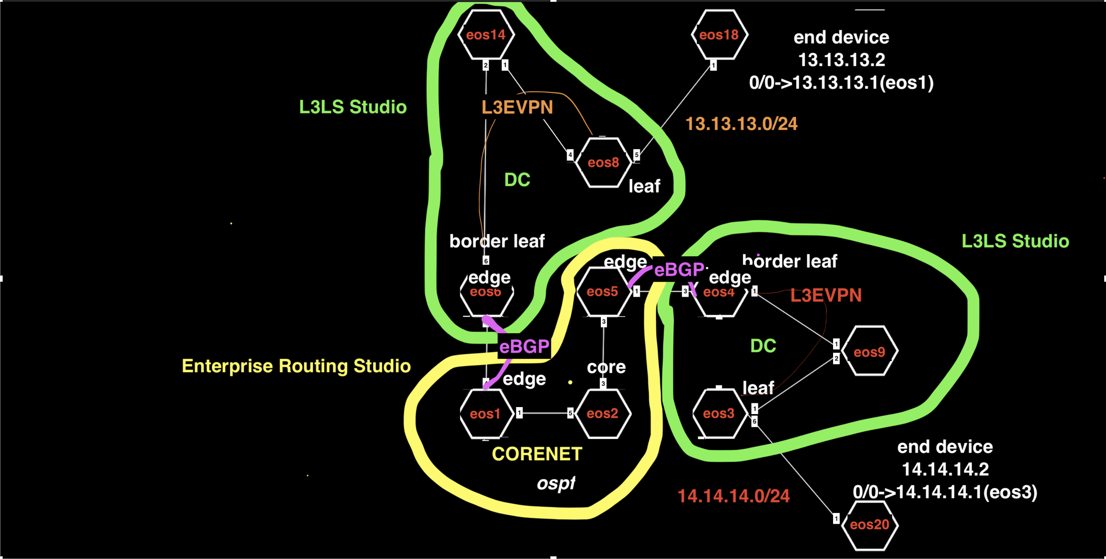
Example2

Slide 22
Example 2 Tags
See tagsfile.txt to load tags through the API with tagman.py
DC-Pod:1 - EOS14
DC-Pod:1 - EOS6
DC-Pod:1 - EOS8
DC-Pod:2 - EOS3
DC-Pod:2 - EOS4
DC-Pod:2 - EOS9
DC:DC-eos3-eos4-eos9 - EOS3
DC:DC-eos3-eos4-eos9 - EOS4
DC:DC-eos3-eos4-eos9 - EOS9
DC:DC-eos6-eos8-eos14 - EOS14
DC:DC-eos6-eos8-eos14 - EOS6
DC:DC-eos6-eos8-eos14 - EOS8
Edge-Router-Domain:1 - EOS1
Edge-Router-Domain:18 - EOS18
Edge-Router-Domain:20 - EOS20
Edge-Router-Domain:4 - EOS4
Edge-Router-Domain:5 - EOS5
Edge-Router-Domain:6 - EOS6
Leaf-Domain:1 - EOS6
Leaf-Domain:2 - EOS8
Leaf-Domain:3 - EOS3
Leaf-Domain:4 - EOS4
Leaf-Number:1 - EOS4
Leaf-Number:1 - EOS6
Leaf-Number:2 - EOS3
Leaf-Number:2 - EOS8
Network:CoreNet-eos1-eos2-eos5 - EOS1
Network:CoreNet-eos1-eos2-eos5 - EOS2
Network:CoreNet-eos1-eos2-eos5 - EOS5
Network:DC-Border-Leaf-eos4 - EOS4
Network:DC-Border-Leaf-eos6 - EOS6
Network:DC-End-device-eos18 - EOS18
Network:DC-End-device-eos20 - EOS20
Role:Core - EOS2
Role:Edge-Router - EOS1
Role:Edge-Router - EOS5
Role:Leaf - EOS3
Role:Leaf - EOS4
Role:Leaf - EOS6
Role:Leaf - EOS8
Role:Spine - EOS14
Role:Spine - EOS9
Spine-Number:1 - EOS14
Spine-Number:1 - EOS9
router_bgp.router_id:1.1.1.1 - EOS1
router_bgp.router_id:2.2.2.2 - EOS2
router_bgp.router_id:5.5.5.5 - EOS5

Slide 23
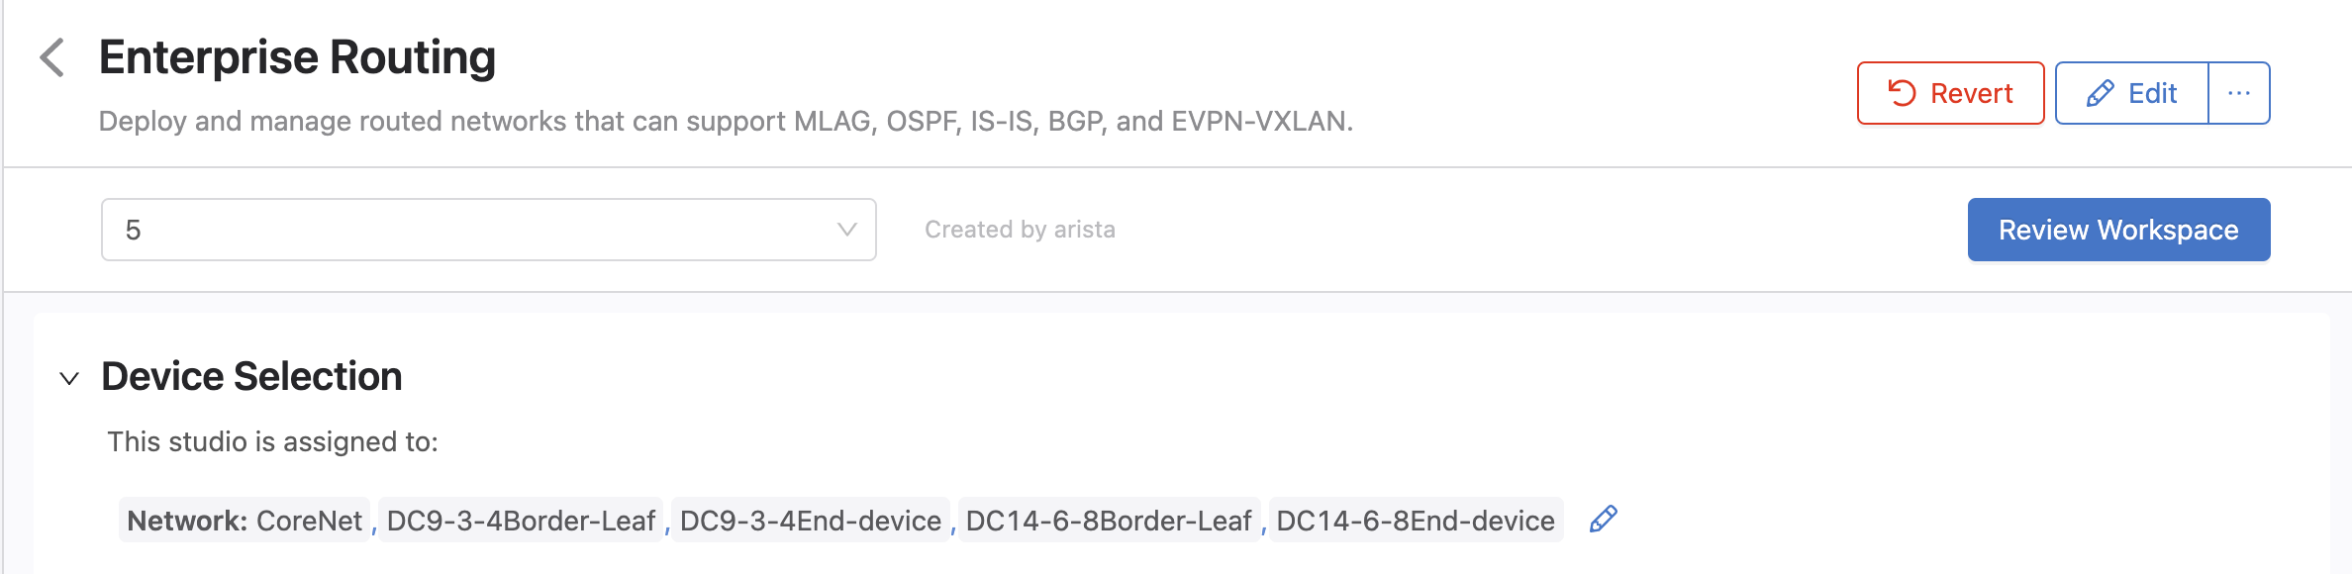
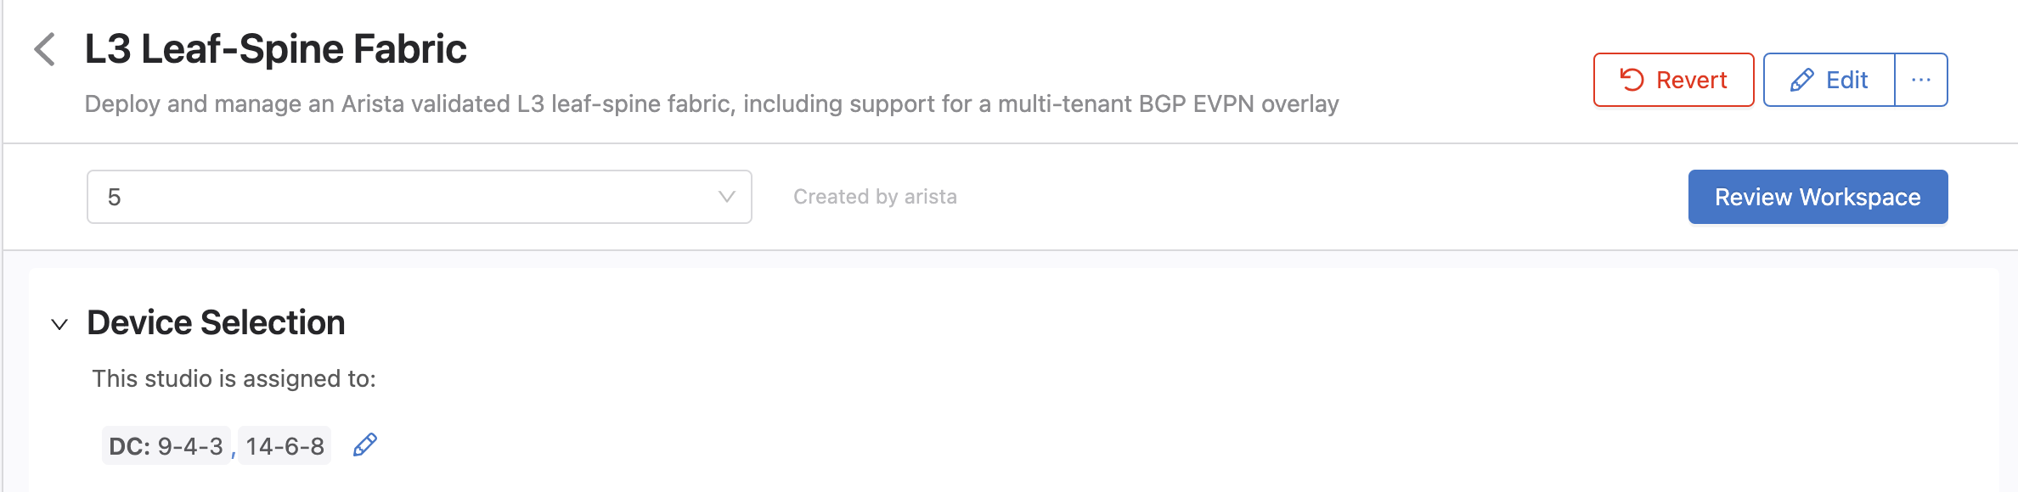
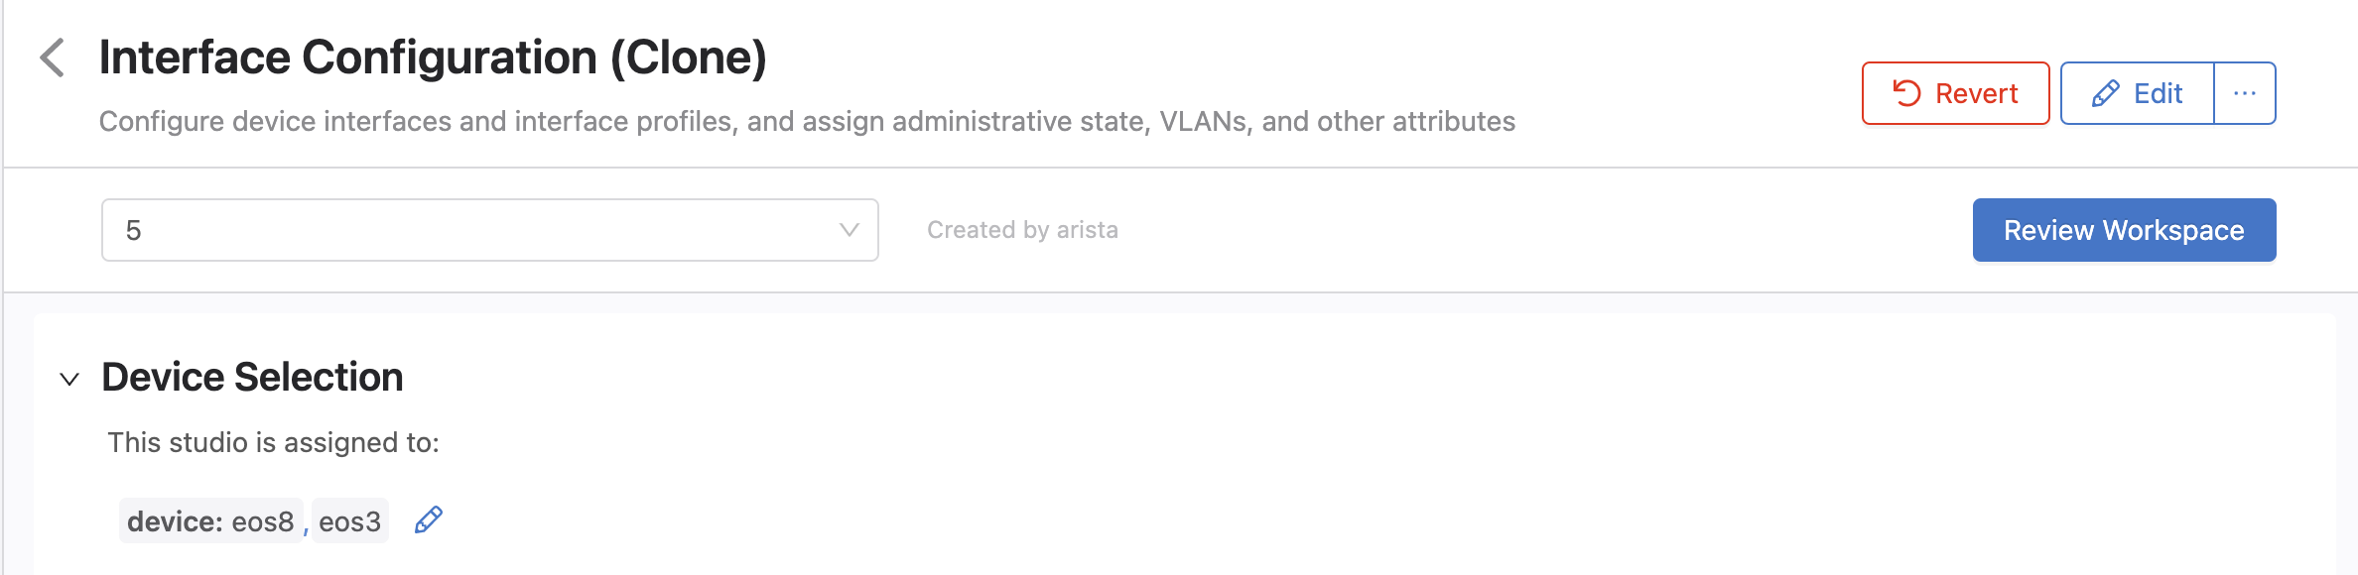
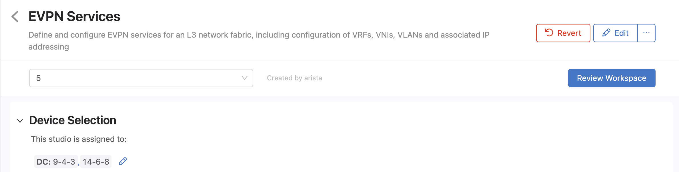
Device Selection

Slide 24
Test
From eos18 ping eos20 14.14.14.2
You may have to clear the arp cache on eos18 between the mac address of its default gateway has changed from the previous example

Slide 25
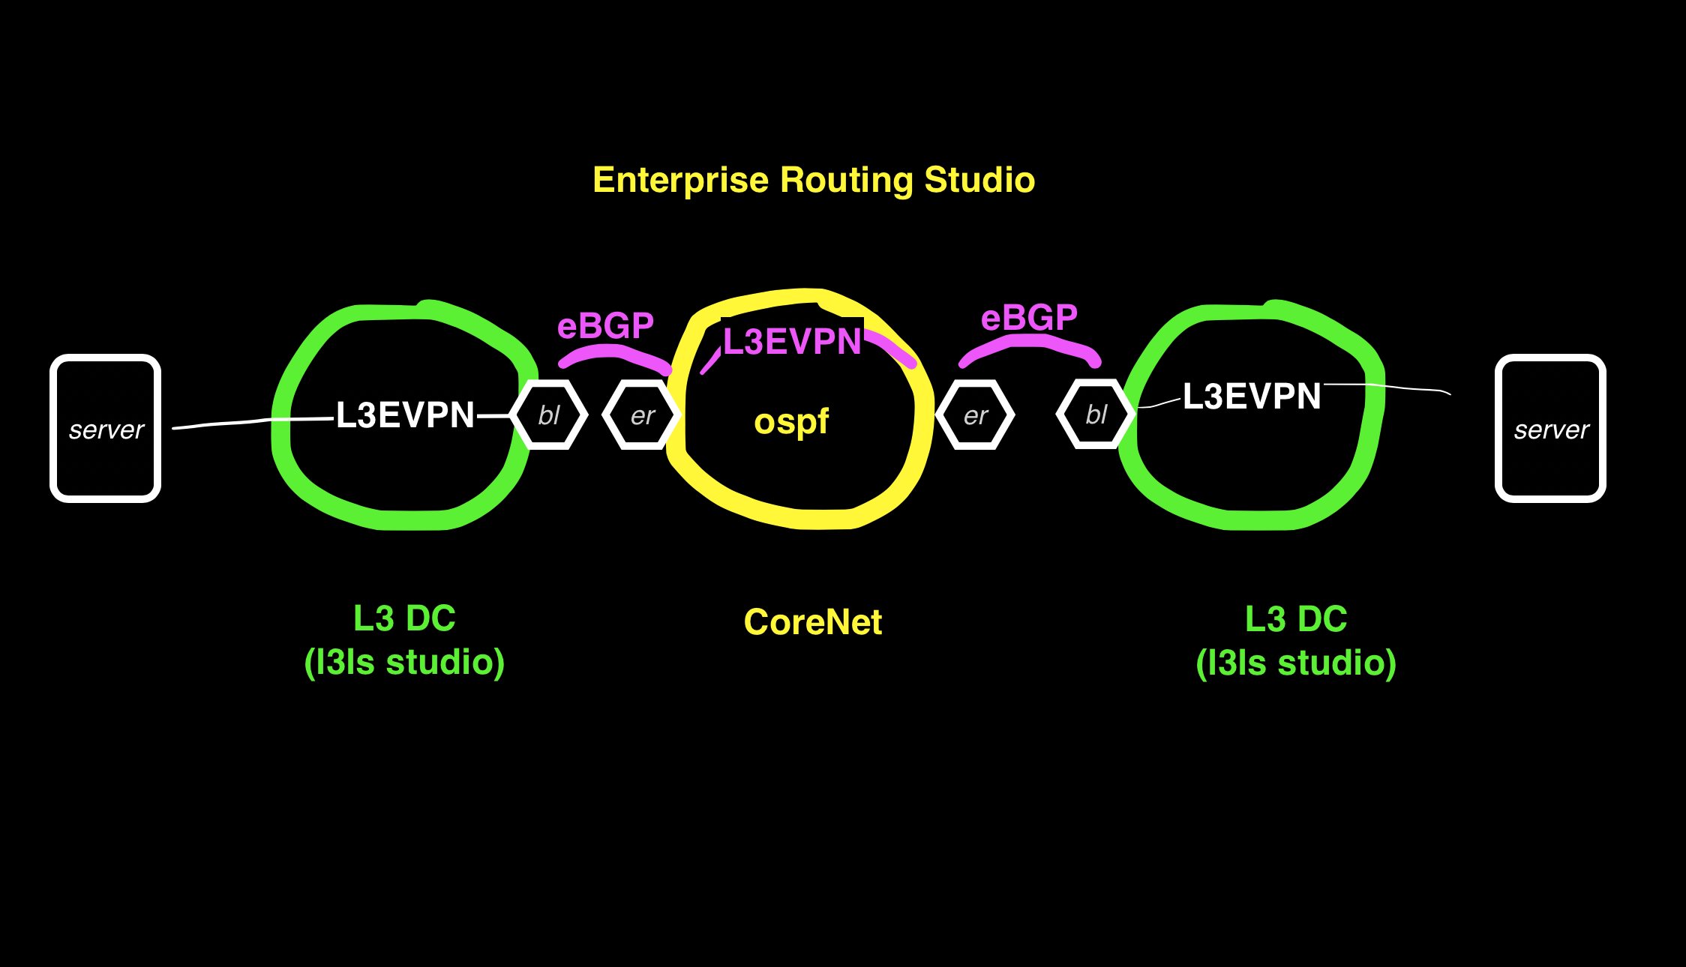
Example 3 EVPN over Enterprise Network

Slide 26
Example3: L3EVPN on CoreNet
In this example the Enterprise Routing Studio is configured to put the traffic in an L3EVPN between the DCs and over a 3rd L3EVPN segment in the Enterprise Core
The border leafs have eBGP sessions to the Edge Routers and the interface on the Edge Router side is in a VRF.
Clone the EVPN Services Studio – it will be used for the EVPN over the Enterprise Core Network. This will avoid the limitation of a vlan id cannot be reused even if it is on a different network (vlan between border leafs and edge router for example)

Slide 27
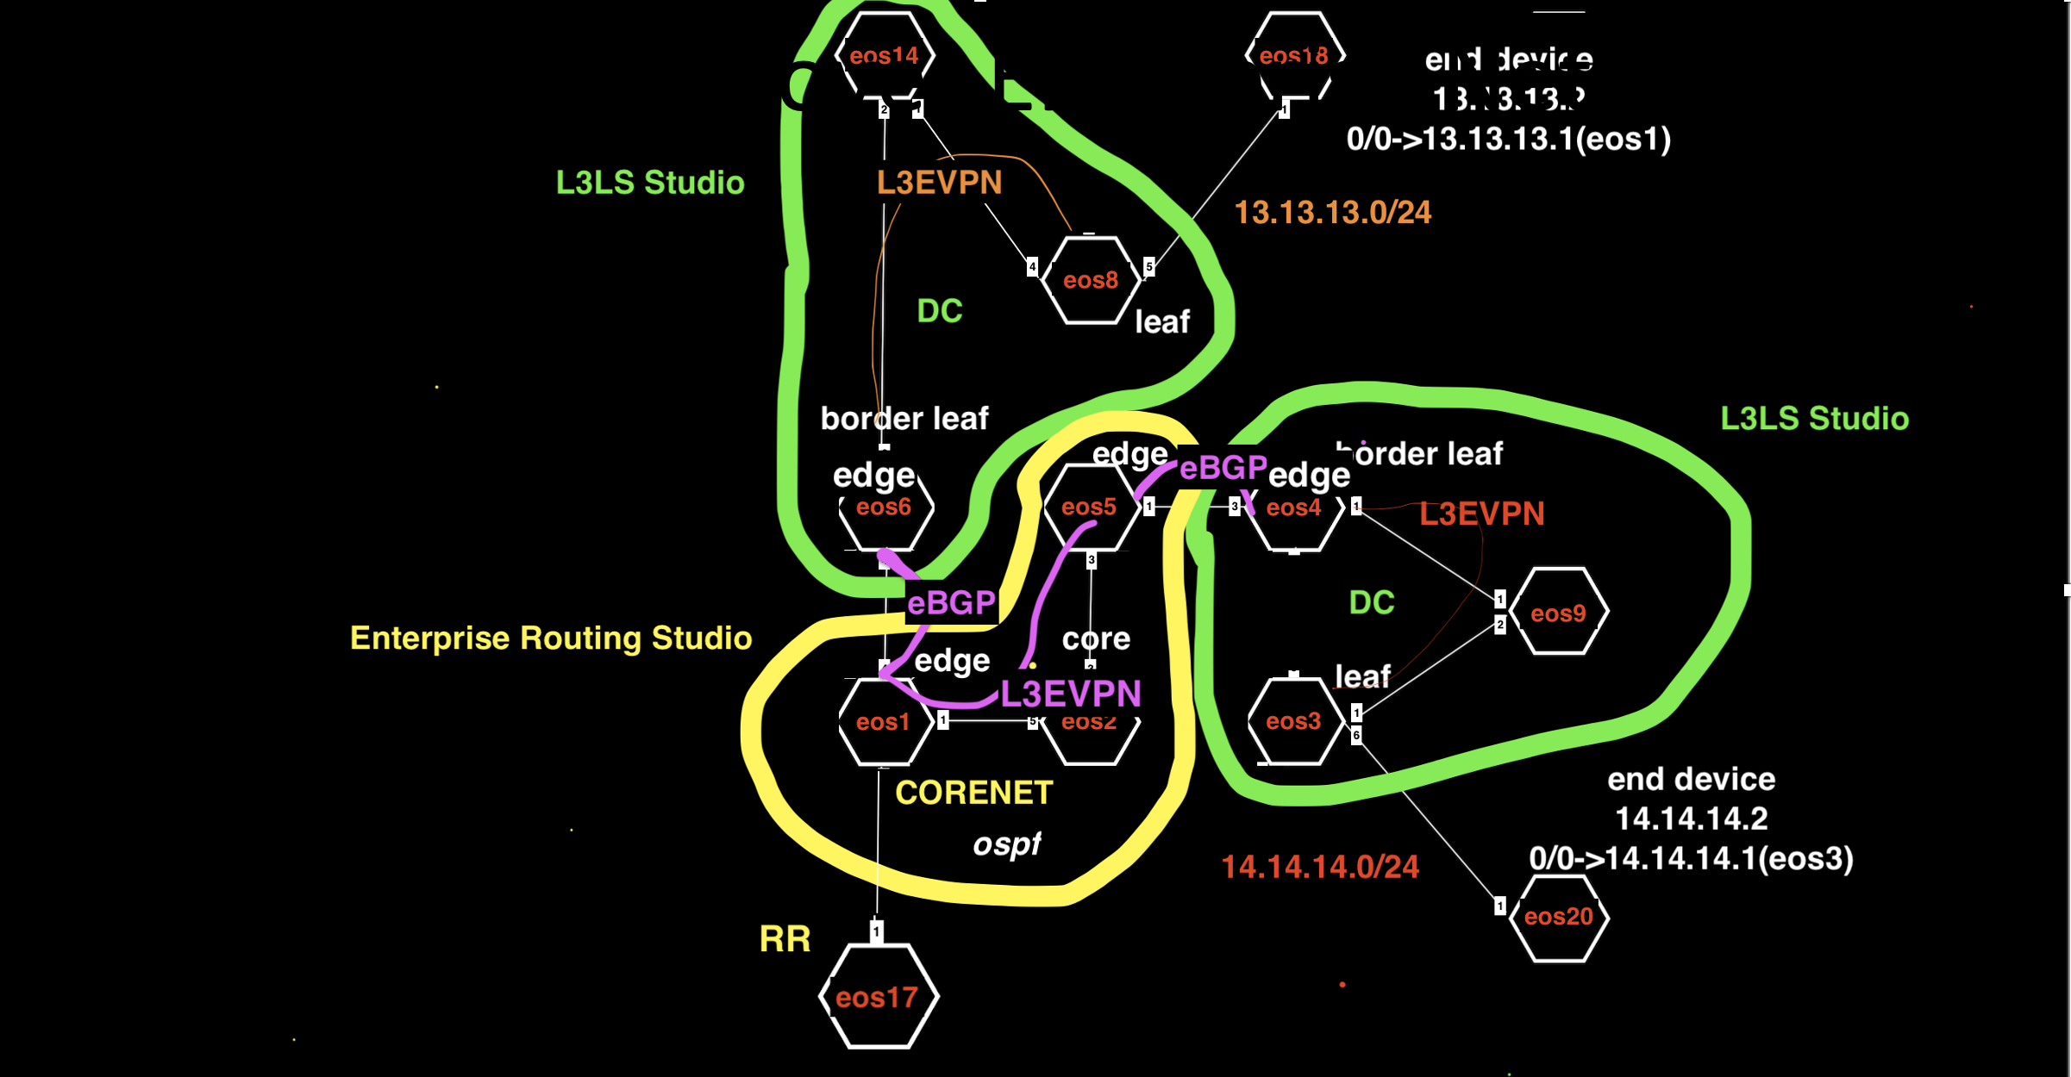
Example3: EVPN over Enterprise Network

Slide 28
Example3 Tags
See tagsfile.txt to load tags through the API with tagman.py
DC-Pod:1 - EOS14
DC-Pod:1 - EOS6
DC-Pod:1 - EOS8
DC-Pod:2 - EOS3
DC-Pod:2 - EOS4
DC-Pod:2 - EOS9
DC:DC-eos3-eos4-eos9 - EOS3
DC:DC-eos3-eos4-eos9 - EOS4
DC:DC-eos3-eos4-eos9 - EOS9
DC:DC-eos6-eos8-eos14 - EOS14
DC:DC-eos6-eos8-eos14 - EOS6
DC:DC-eos6-eos8-eos14 - EOS8
Edge-Router-Domain:1 - EOS1
Edge-Router-Domain:18 - EOS18
Edge-Router-Domain:20 - EOS20
Edge-Router-Domain:4 - EOS4
Edge-Router-Domain:5 - EOS5
Edge-Router-Domain:6 - EOS6
Leaf-Domain:1 - EOS6
Leaf-Domain:2 - EOS8
Leaf-Domain:3 - EOS3
Leaf-Domain:4 - EOS4
Leaf-Number:1 - EOS4
Leaf-Number:1 - EOS6
Leaf-Number:2 - EOS3
Leaf-Number:2 - EOS8
Network:CoreNet-eos1-eos2-eos5-eos17 - EOS1
Network:CoreNet-eos1-eos2-eos5-eos17 - EOS17
Network:CoreNet-eos1-eos2-eos5-eos17 - EOS2
Network:CoreNet-eos1-eos2-eos5-eos17 - EOS5
Network:DC-Border-Leaf-eos4 - EOS4
Network:DC-Border-Leaf-eos6 - EOS6
Network:DC-End-device-eos18 - EOS18
Network:DC-End-device-eos20 - EOS20
Role:Core - EOS2
Role:Edge-Router - EOS1
Role:Edge-Router - EOS5
Role:Leaf - EOS3
Role:Leaf - EOS4
Role:Leaf - EOS6
Role:Leaf - EOS8
Role:RR - EOS17
Role:Spine - EOS14
Role:Spine - EOS9
Spine-Number:1 - EOS14
Spine-Number:1 - EOS9
router_bgp.router_id:1.1.1.1 - EOS1
router_bgp.router_id:17.17.17.17
router_bgp.router_id:2.2.2.2 - EOS2
router_bgp.router_id:5.5.5.5 - EOS5

Slide 29
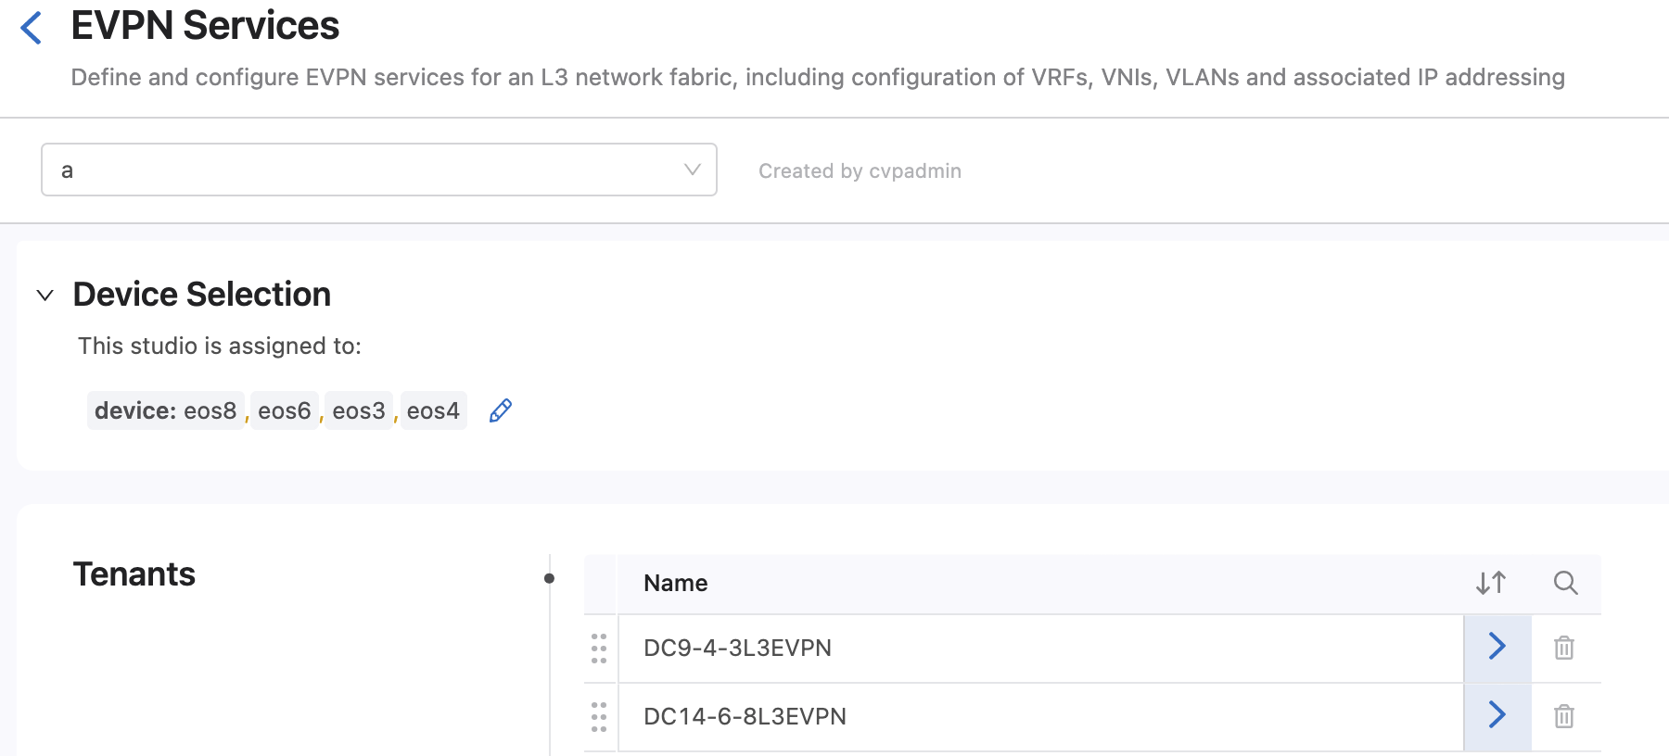
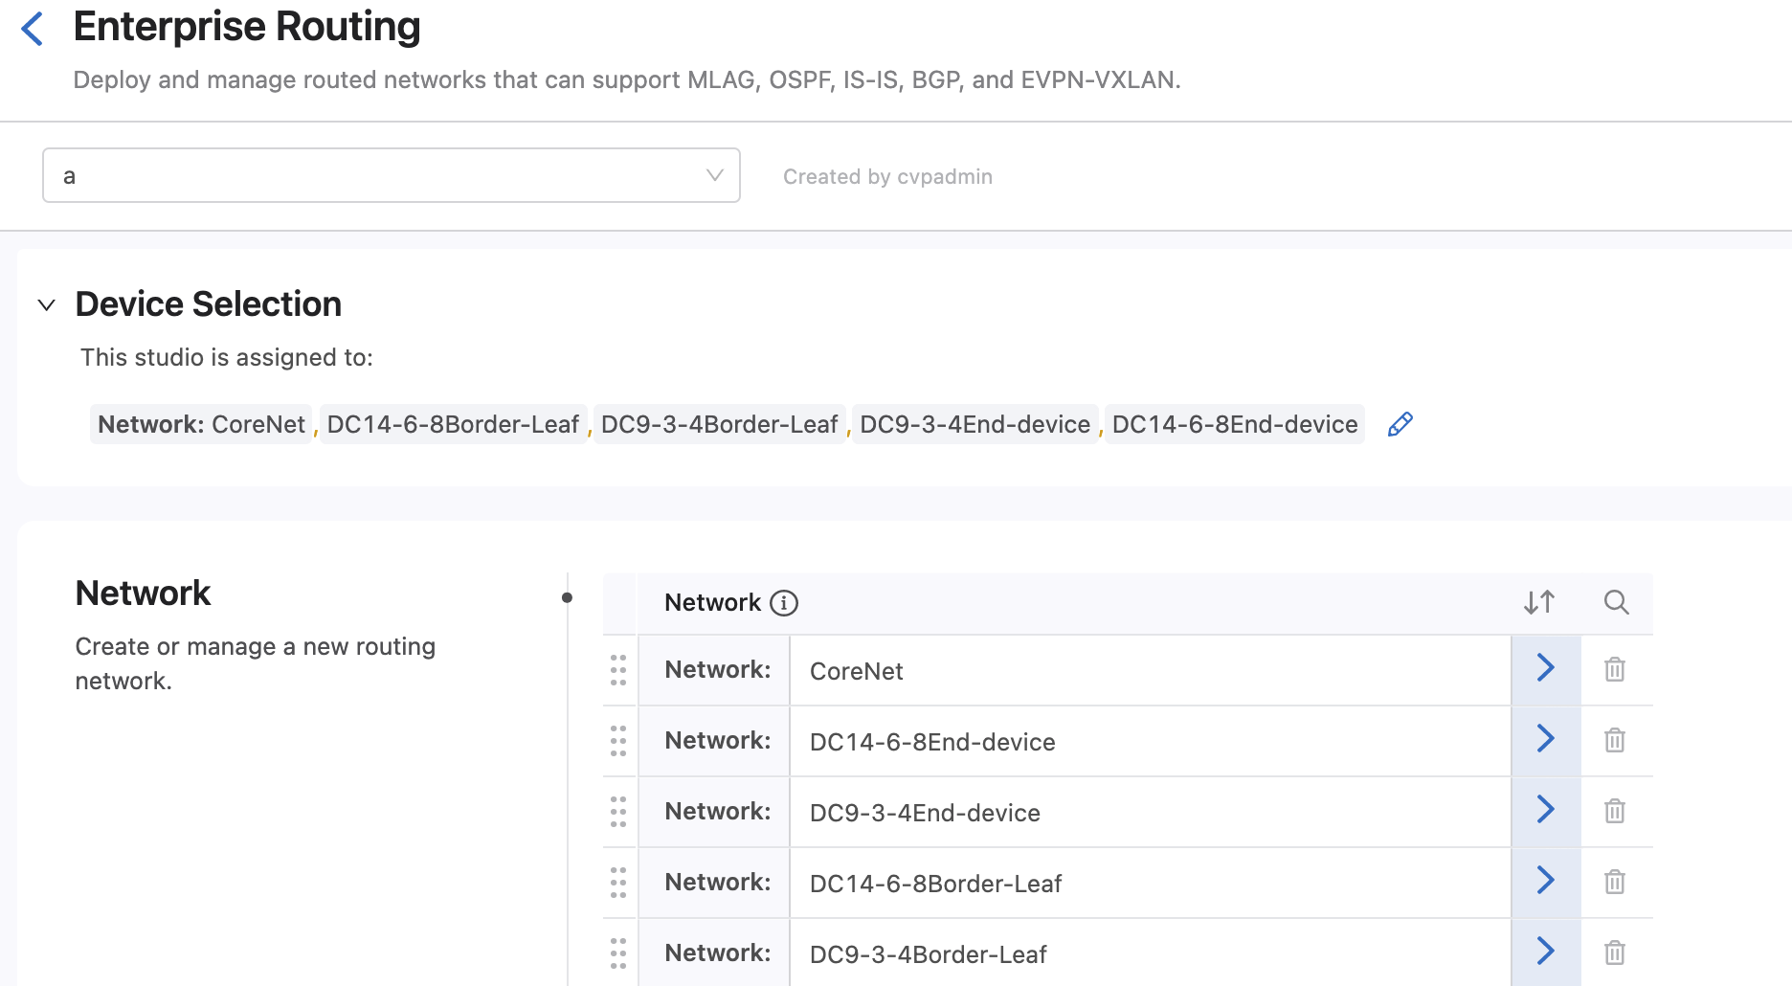
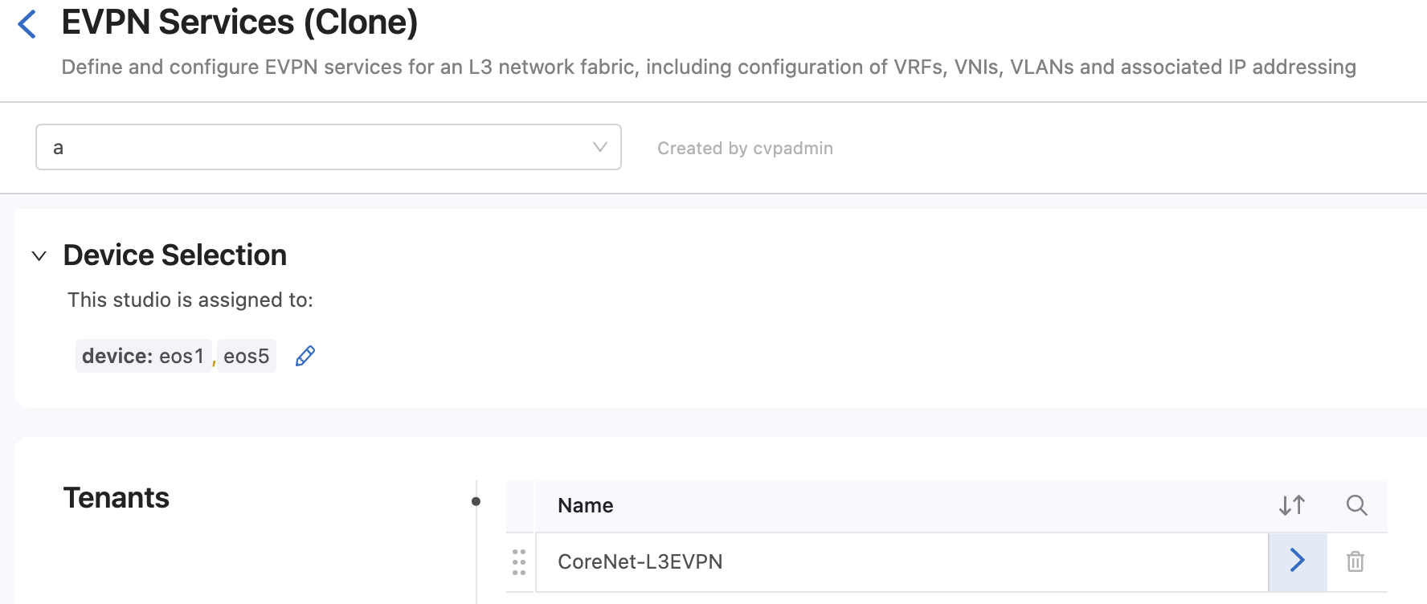
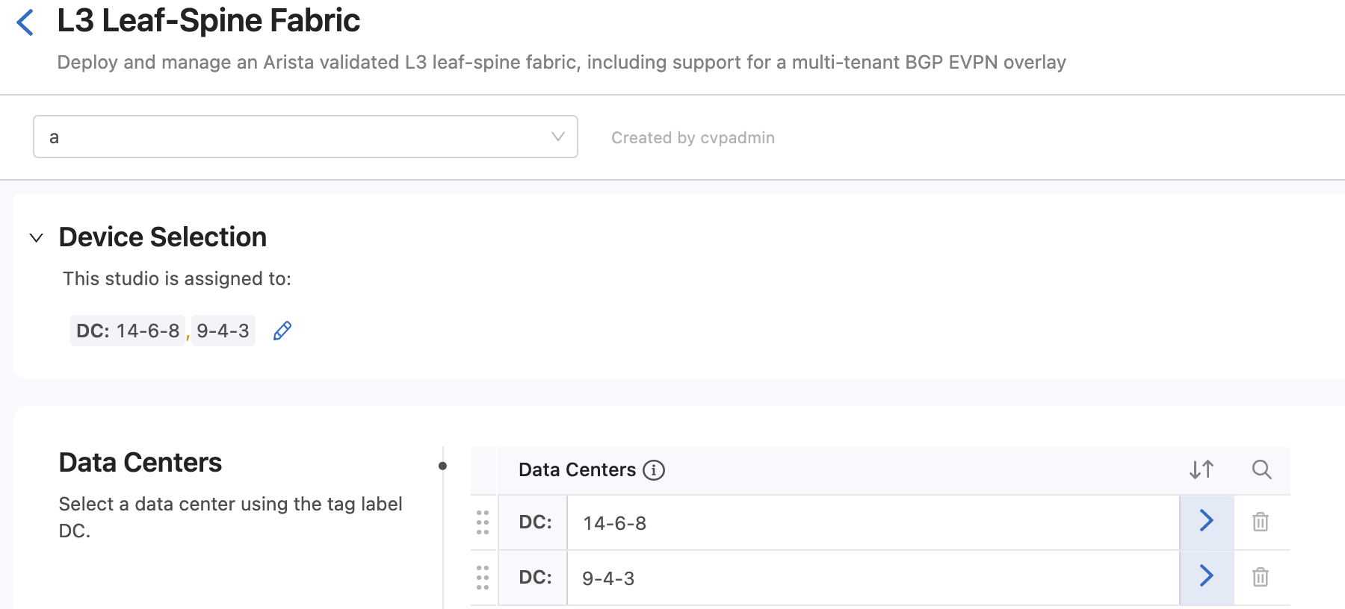
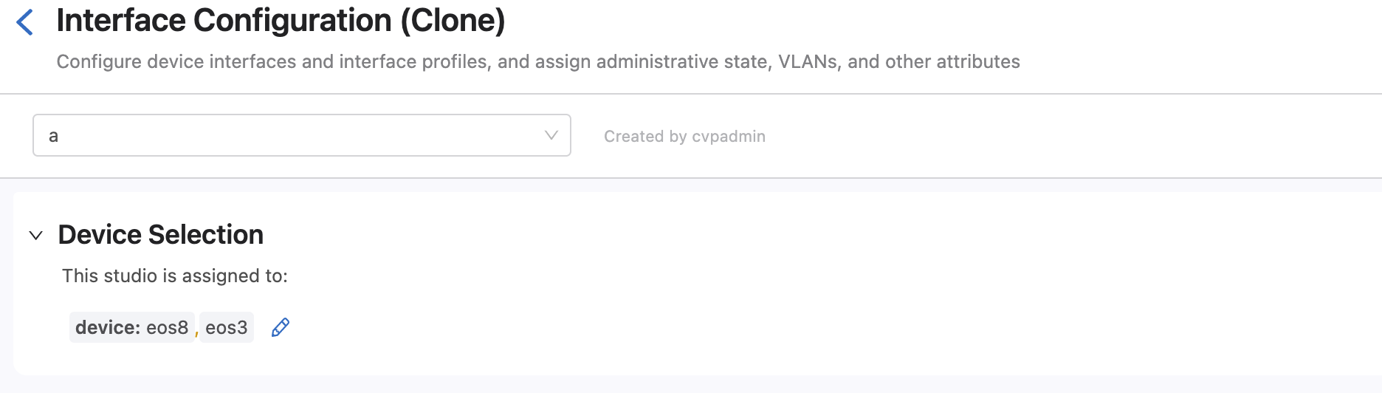
Device Selection
Clone the EVPN Services Studio. This clone will be used for the EVPN over the Enterprise Core Network

Slide 30
Test
From eos18 ping eos20 14.14.14.2
You may have to clear the arp cache on eos18 between the mac address of its default gateway has changed from the previous example

Slide 31
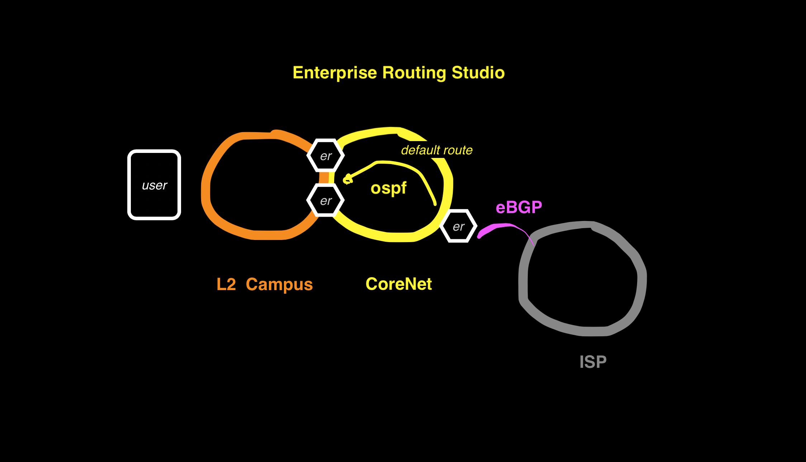
Example 4 Routing Campus to ISP

Slide 32
Example4: Routing OSPF Campus to ISP Campus receives Default Route Campus edge router has full Internet routes in this example
In this example the Enterprise Routing Studio, consisting of 3 Edge Routers route a Campus to the Internet
ISP sends full routes but Edge Router sends only a default route to the Campus Splines
Ping from Campus switch eos12 15.15.15.4/24 to eos10 on ISP network 10.10.10.10

Slide 33
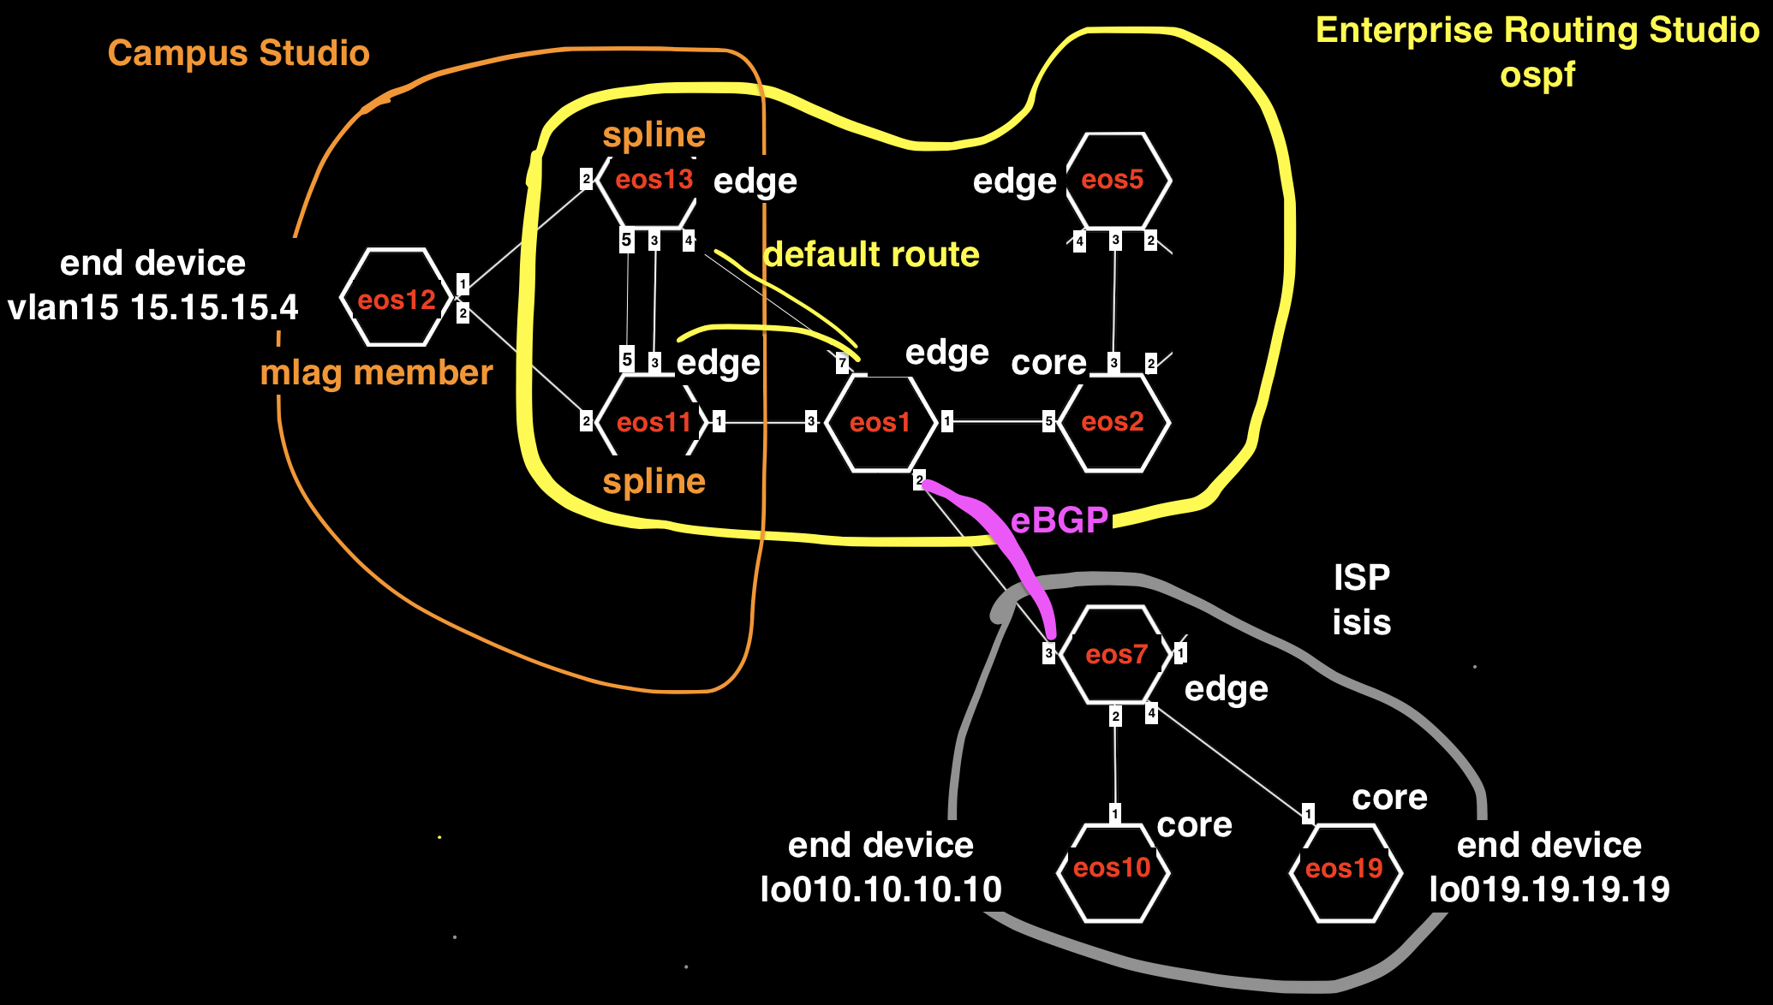
Example4:
core
edge

Slide 34
Example 4 Tags
See tagsfile.txt to load tags through the API with tagman.py
Campus-Pod:12 - EOS12
Campus:Campus-eos11-eos12-eos13 - EOS11
Campus:Campus-eos11-eos12-eos13 - EOS12
Campus:Campus-eos11-eos12-eos13 - EOS13
Edge-Router-Domain:7 - EOS7
Edge-Router-Domain:Campus11-13 - EOS11
Edge-Router-Domain:Campus11-13 - EOS13
Network:CoreNet-eos1-eos2-eos5-eos11-eos13 - EOS1
Network:CoreNet-eos1-eos2-eos5-eos11-eos13 - EOS11
Network:CoreNet-eos1-eos2-eos5-eos11-eos13 - EOS13
Network:CoreNet-eos1-eos2-eos5-eos11-eos13 - EOS2
Network:CoreNet-eos1-eos2-eos5-eos11-eos13 - EOS5
Network:ISP-eos7-eos10-eos19 - EOS10
Network:ISP-eos7-eos10-eos19 - EOS19
Network:ISP-eos7-eos10-eos19 - EOS7
Role:Core - EOS1
Role:Core - EOS10
Role:Core - EOS19
Role:Edge-Router - EOS11
Role:Edge-Router - EOS13
Role:Edge-Router - EOS2
Role:Edge-Router - EOS5
Role:Edge-Router - EOS7
router_bgp.router_id:1.1.1.1 - EOS1
router_bgp.router_id:10.10.10.10 - EOS10
router_bgp.router_id:11.11.11.11 - EOS11
router_bgp.router_id:13.13.13.13 - EOS13
router_bgp.router_id:19.19.19.19 - EOS19
router_bgp.router_id:7.7.7.7 - EOS7

Slide 35
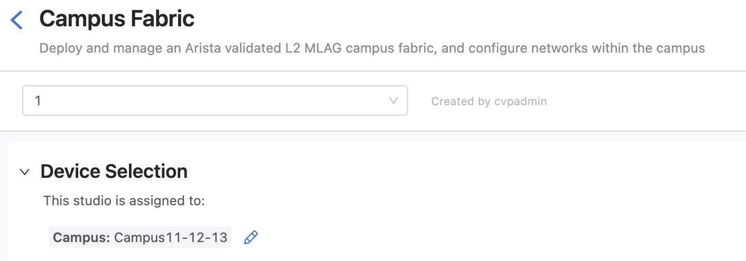
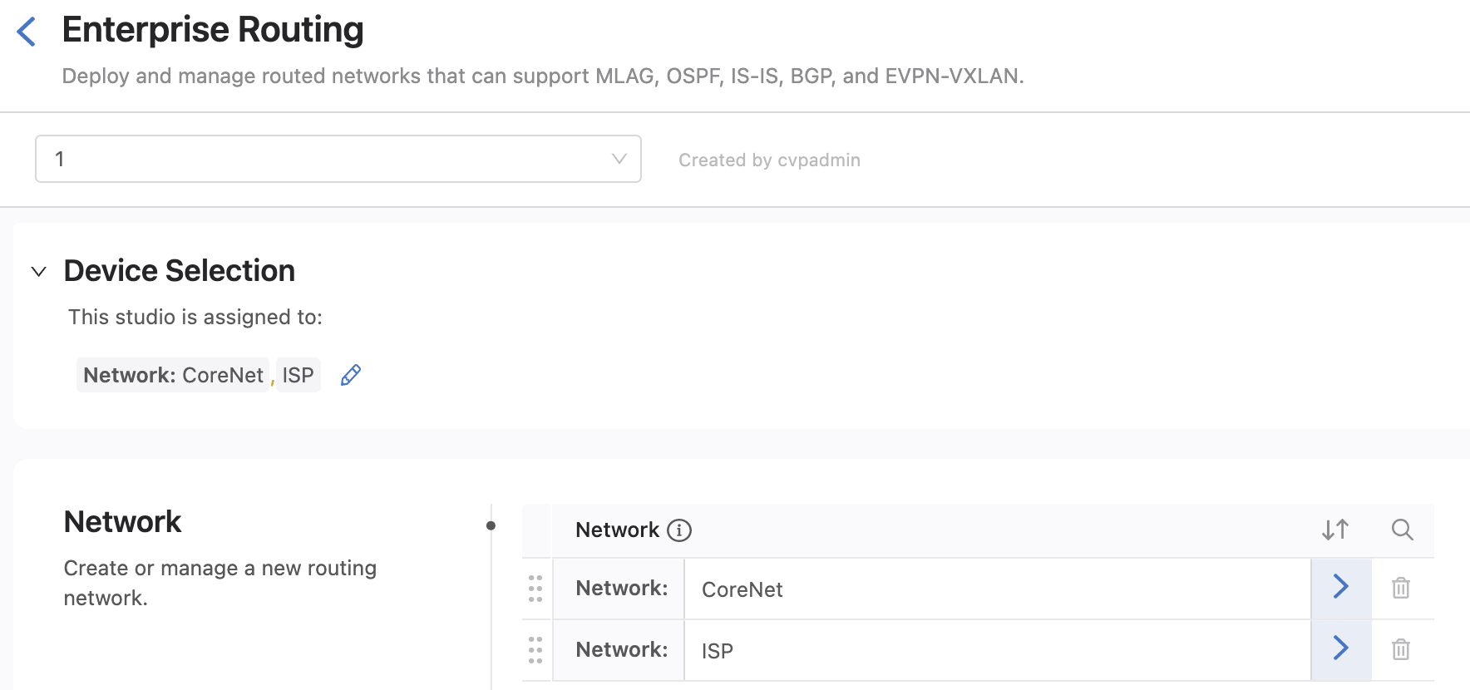
Device Selection

Slide 36
Test
From Campus switch eos12 ping to eos10 on the ISP network 10.10.10.10

Slide 37
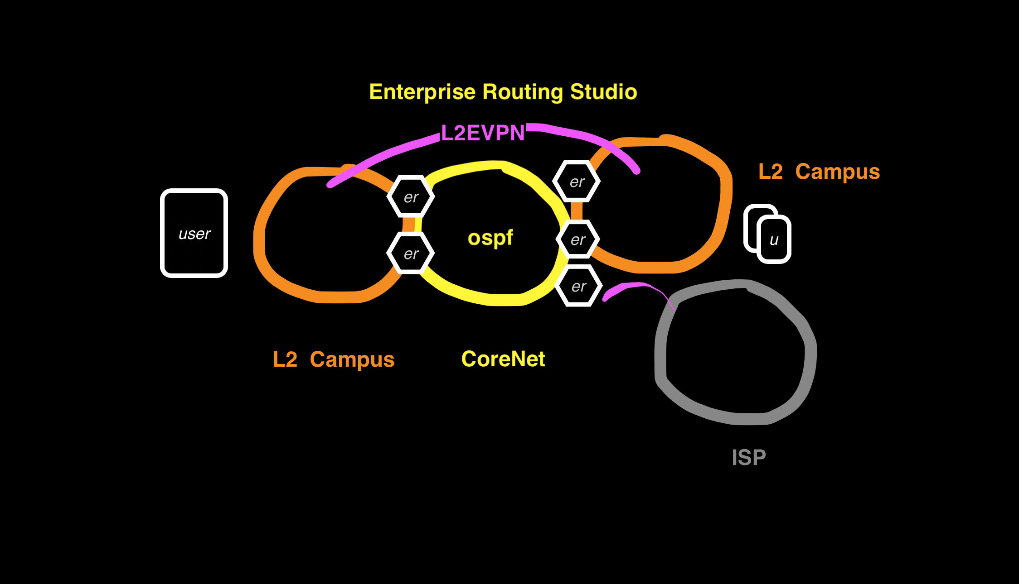
Example 5 EVPN between Campus

Slide 38
Example5: EVPN between Campus L2 stretch is demonstrated in this example
In this example the Enterprise Routing Studio, consisting of 3 Edge Routers route a Campus to the Internet
ISP sends full routes but Edge Router sends only a default route to the Campus Splines
Ping from Campus switch eos12 15.15.15.4/24 to eos10 on ISP network 10.10.10.10

Slide 39
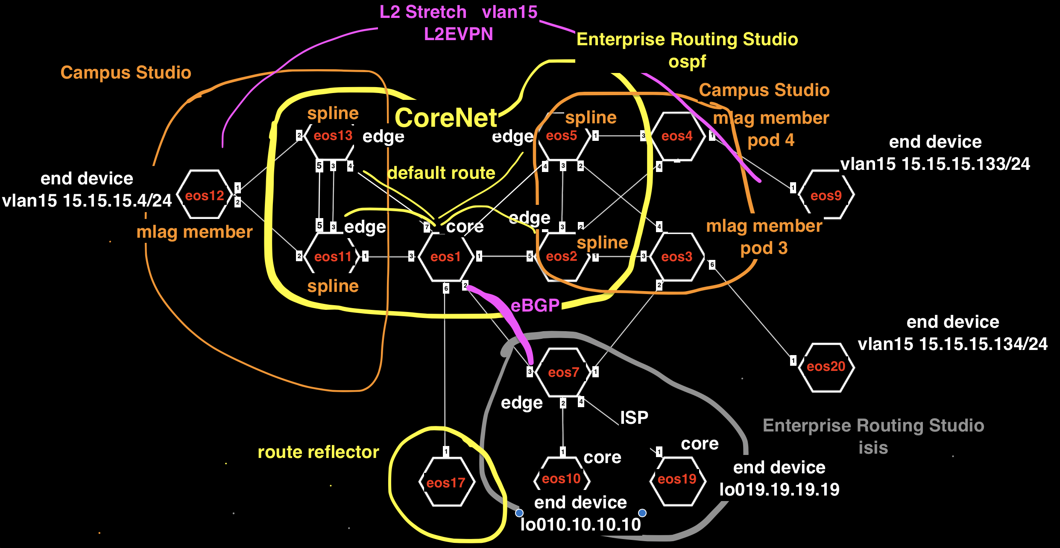
Example5:

Slide 40
Example 5 Tags
See tagsfile.txt to load tags through the API with tagman.py
Campus-Pod:12 - EOS12
Campus-Pod:3 - EOS3
Campus-Pod:4 - EOS4
Campus:Campus-eos11-eos12-eos13 - EOS11
Campus:Campus-eos11-eos12-eos13 - EOS12
Campus:Campus-eos11-eos12-eos13 - EOS13
Campus:Campus-eos2-eos3-eos4-eos5 - EOS2
Campus:Campus-eos2-eos3-eos4-eos5 - EOS3
Campus:Campus-eos2-eos3-eos4-eos5 - EOS4
Campus:Campus-eos2-eos3-eos4-eos5 - EOS5
Edge-Router-Domain:20 - EOS20
Edge-Router-Domain:7 - EOS7
Edge-Router-Domain:9 - EOS9
Edge-Router-Domain:Campus11-13 - EOS11
Edge-Router-Domain:Campus11-13 - EOS13
Edge-Router-Domain:Campus2-5 - EOS2
Edge-Router-Domain:Campus2-5 - EOS5
Network:Campus-EndDevice-eos20 - EOS20
Network:Campus-EndDevice-eos9 - EOS9
Network:CoreNet-eos1-eos2-eos5-eos11-eos13-eos17 - EOS1
Network:CoreNet-eos1-eos2-eos5-eos11-eos13-eos17 - EOS11
Network:CoreNet-eos1-eos2-eos5-eos11-eos13-eos17 - EOS13
Network:CoreNet-eos1-eos2-eos5-eos11-eos13-eos17 - EOS17
Network:CoreNet-eos1-eos2-eos5-eos11-eos13-eos17 - EOS2
Network:CoreNet-eos1-eos2-eos5-eos11-eos13-eos17 - EOS5
Network:ISP-eos7-eos10-eos19 - EOS10
Network:ISP-eos7-eos10-eos19 - EOS19
Network:ISP-eos7-eos10-eos19 - EOS7
Role:Core - EOS1
Role:Core - EOS10
Role:Core - EOS19
Role:Edge-Router - EOS11
Role:Edge-Router - EOS13
Role:Edge-Router - EOS2
Role:Edge-Router - EOS20
Role:Edge-Router - EOS5
Role:Edge-Router - EOS7
Role:RR - EOS17
router_bgp.router_id:1.1.1.1 - EOS1
router_bgp.router_id:10.10.10.10 - EOS10
router_bgp.router_id:11.11.11.11 - EOS11
router_bgp.router_id:13.13.13.13 - EOS13
router_bgp.router_id:17.17.17.17 - EOS17
router_bgp.router_id:19.19.19.19 - EOS19
router_bgp.router_id:2.2.2.2 - EOS2
router_bgp.router_id:5.5.5.5 - EOS5
router_bgp.router_id:7.7.7.7 - EOS7

Slide 41
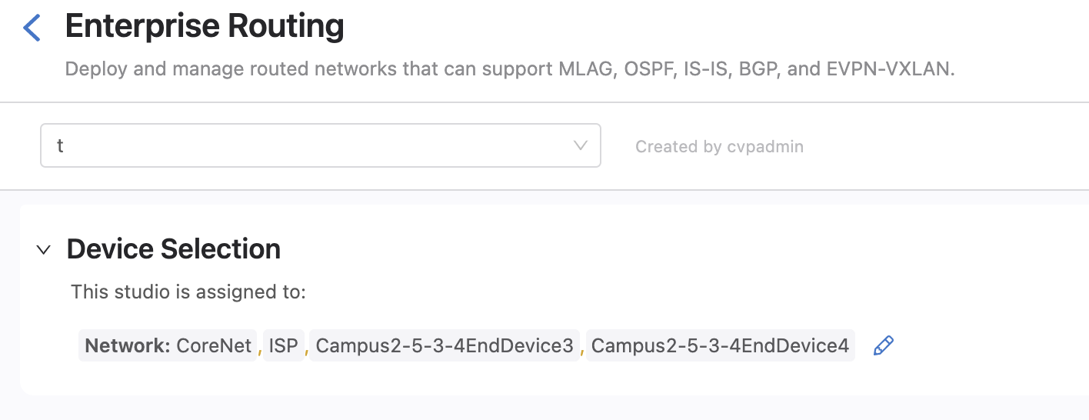
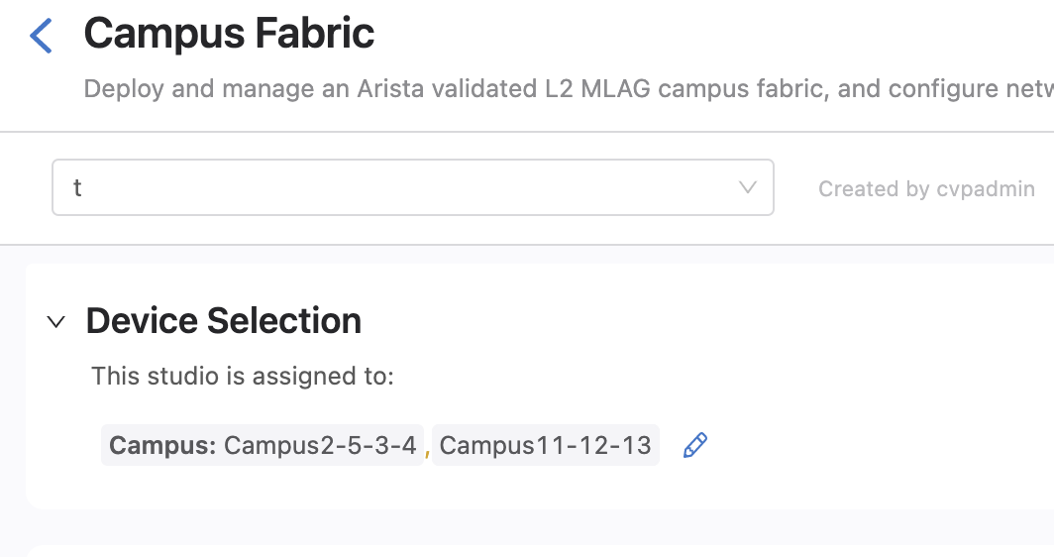
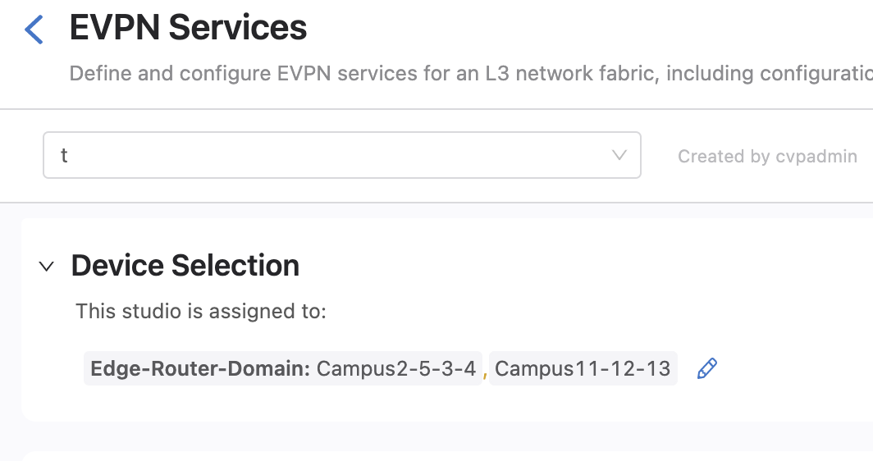
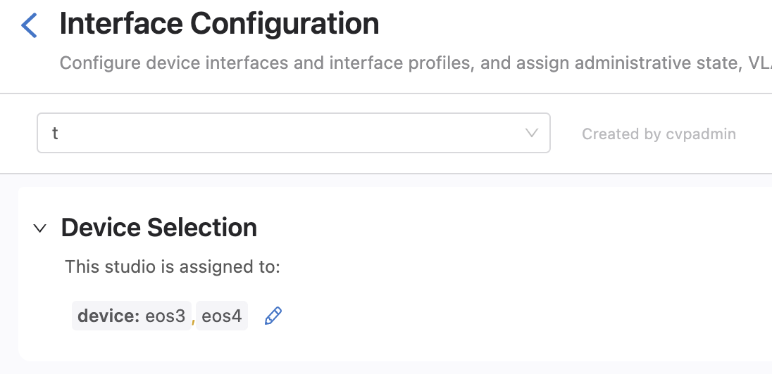
Device Selection

Slide 42
Test
From Campus switch eos12 ping DC end device eos9 15.15.15.2
From Campus switch eos12 ping to eos10 on the ISP network 10.10.10.10
From DC end device ping eos10 on ISP network 10.10.10.10

Slide 43
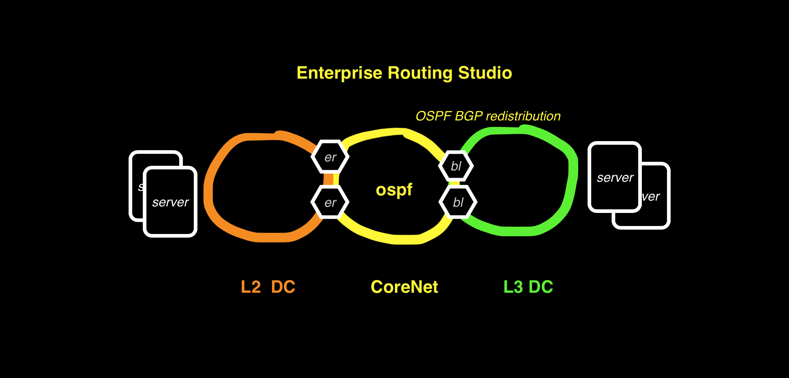
Example 6: OSPF on DC Border Leaf

Slide 44
Example6: OSPF on DC Border Leaf L3DC has no overlay and mutual redistribution of BGP and OSPF routes.
In this example the Enterprise Routing Studio, consisting of 4 Edge Routers and 2 Core Routers routes a L3DC using L3LS Studio to an L2 DC using the Campus Studio.
On the border leafs on the L3 DC BGP to OSPF redistribution is configured using the Enterprise Routing Studio
Border Leafs are set to the same ASN in the L3LS Studio to prevent routing loops

Slide 45
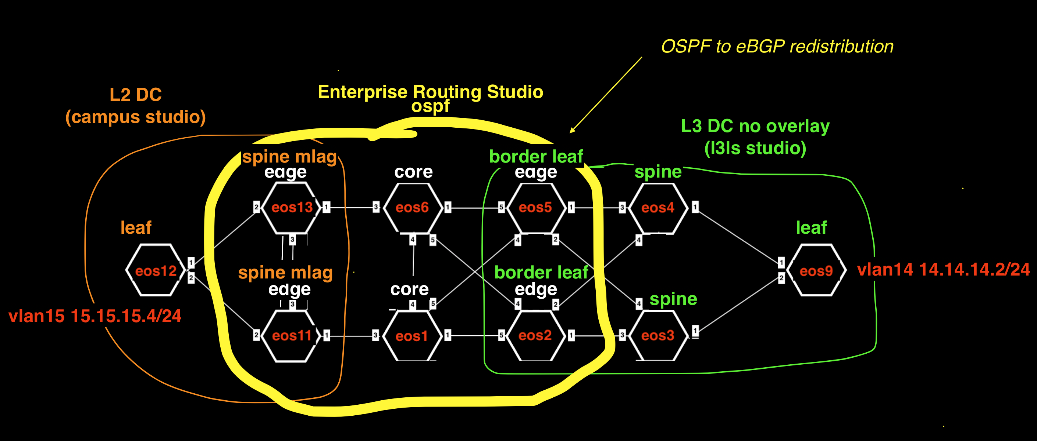
Example6:

Slide 46
Example 6 Tags
See tagsfile.txt to load tags through the API with tagman.py
Campus-Pod:L2DC-eos12 - EOS12
Campus:L2DC-eos11-eos12-eos13 - EOS11
Campus:L2DC-eos11-eos12-eos13 - EOS12
Campus:L2DC-eos11-eos12-eos13 - EOS13
Campus:L3DC-End-device-eos9 - EOS9
DC-Pod:1 - EOS2
DC-Pod:1 - EOS3
DC-Pod:1 - EOS4
DC-Pod:1 - EOS5
DC-Pod:1 - EOS9
DC:L3DC-eos2-eos3-eos4-eos5-eos9 - EOS2
DC:L3DC-eos2-eos3-eos4-eos5-eos9 - EOS3
DC:L3DC-eos2-eos3-eos4-eos5-eos9 - EOS4
DC:L3DC-eos2-eos3-eos4-eos5-eos9 - EOS5
DC:L3DC-eos2-eos3-eos4-eos5-eos9 - EOS9
Edge-Router-Domain:11-13 - EOS11
Edge-Router-Domain:11-13 - EOS13
Edge-Router-Domain:2 - EOS2
Edge-Router-Domain:5 - EOS5
Edge-Router-Domain:9 - EOS9
Leaf-Domain:2 - EOS2
Leaf-Domain:5 - EOS5
Leaf-Domain:9 - EOS9
Leaf-Number:1 - EOS2
Leaf-Number:2 - EOS5
Leaf-Number:3 - EOS9
Network:CoreNet-eos1-eos2-eos5-eos6-eos11-eos13 - EOS1
Network:CoreNet-eos1-eos2-eos5-eos6-eos11-eos13 - EOS11
Network:CoreNet-eos1-eos2-eos5-eos6-eos11-eos13 - EOS13
Network:CoreNet-eos1-eos2-eos5-eos6-eos11-eos13 - EOS2
Network:CoreNet-eos1-eos2-eos5-eos6-eos11-eos13 - EOS5
Network:CoreNet-eos1-eos2-eos5-eos6-eos11-eos13 - EOS6
Network:L3DC-End-device-eos9 - EOS9
Role:Core - EOS1
Role:Core - EOS6
Role:Edge-Router - EOS11
Role:Edge-Router - EOS13
Role:Edge-Router - EOS2
Role:Edge-Router - EOS5
Role:Leaf - EOS2
Role:Leaf - EOS5
Role:Leaf - EOS9
Role:Spine - EOS3
Role:Spine - EOS4
Spine-Number:1 - EOS4
Spine-Number:2 - EOS3
router_bgp.router_id:1.1.1.1 - EOS1
router_bgp.router_id:11.11.11.11 - EOS11
router_bgp.router_id:13.13.13.13 - EOS13
router_bgp.router_id:6.6.6.6 - EOS6

Slide 47
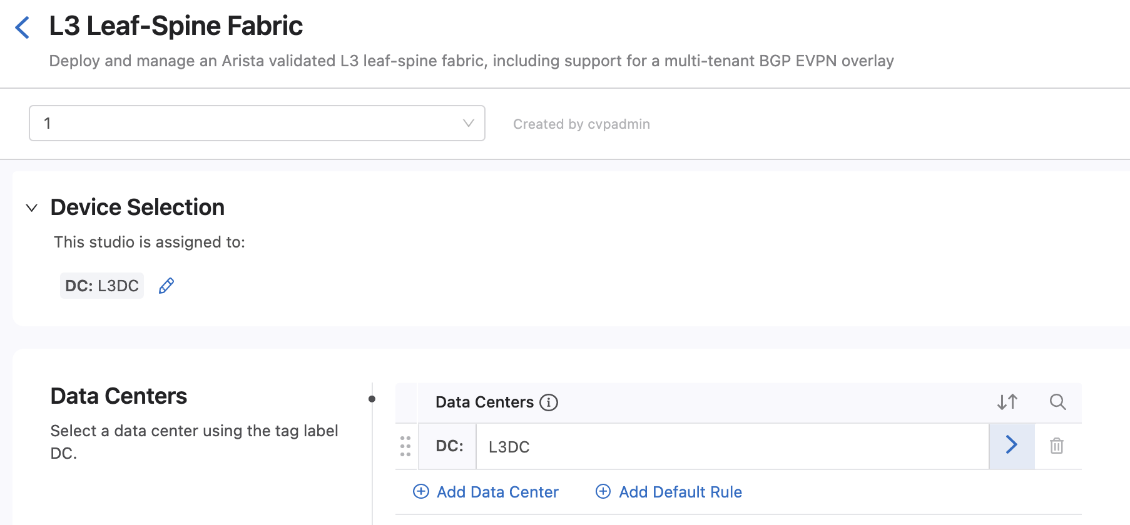
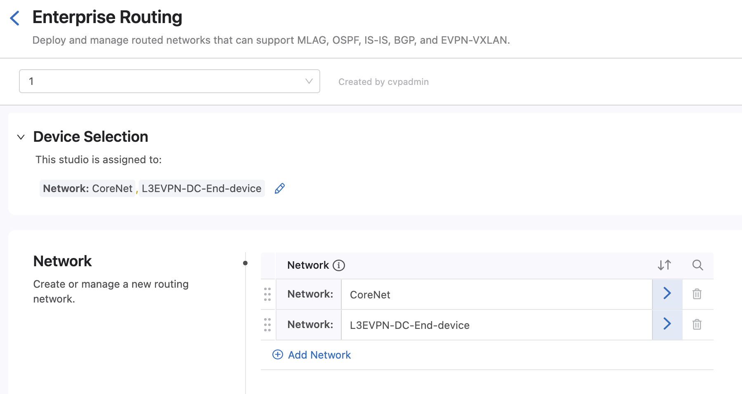
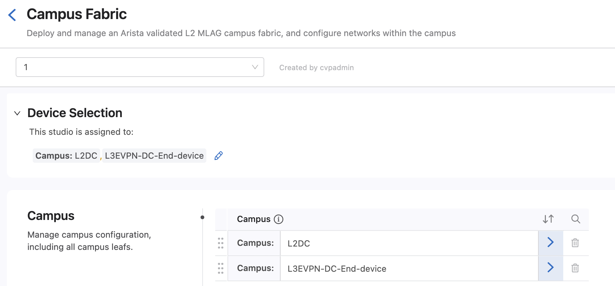
Device Selection

Slide 48
Test
From Campus switch eos12 ping DC Leaf eos9 14.14.14.2
From DC Leaf eos9 14.14.14.2 ping Campus switch eos12

Slide 49
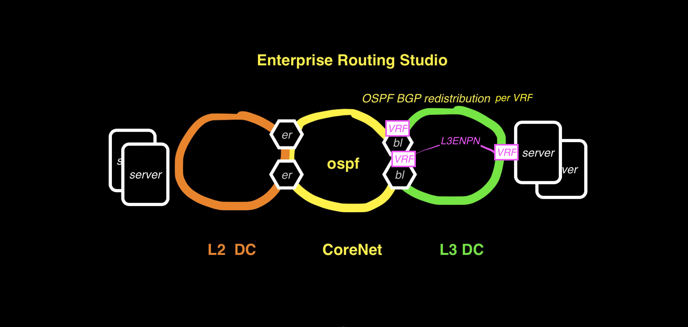
Example 7 OSPF per VRF Border Leaf

Slide 50
Example7: OSPF per Border Leaf VRF L3 DC has EVPN overlay and runs OSPF on Border Leafs in VRF
In this example the Enterprise Routing Studio, consisting of 4 Edge Routers and 2 Core Routers routes a L3DC using L3LS Studio to an L2 DC using the Campus Studio.
On the border leafs on the L3 DC BGP to OSPF redistribution is configured using the Enterprise Routing Studio
Border Leafs are set to the same ASN in the L3LS Studio to prevent routing loops

Slide 51
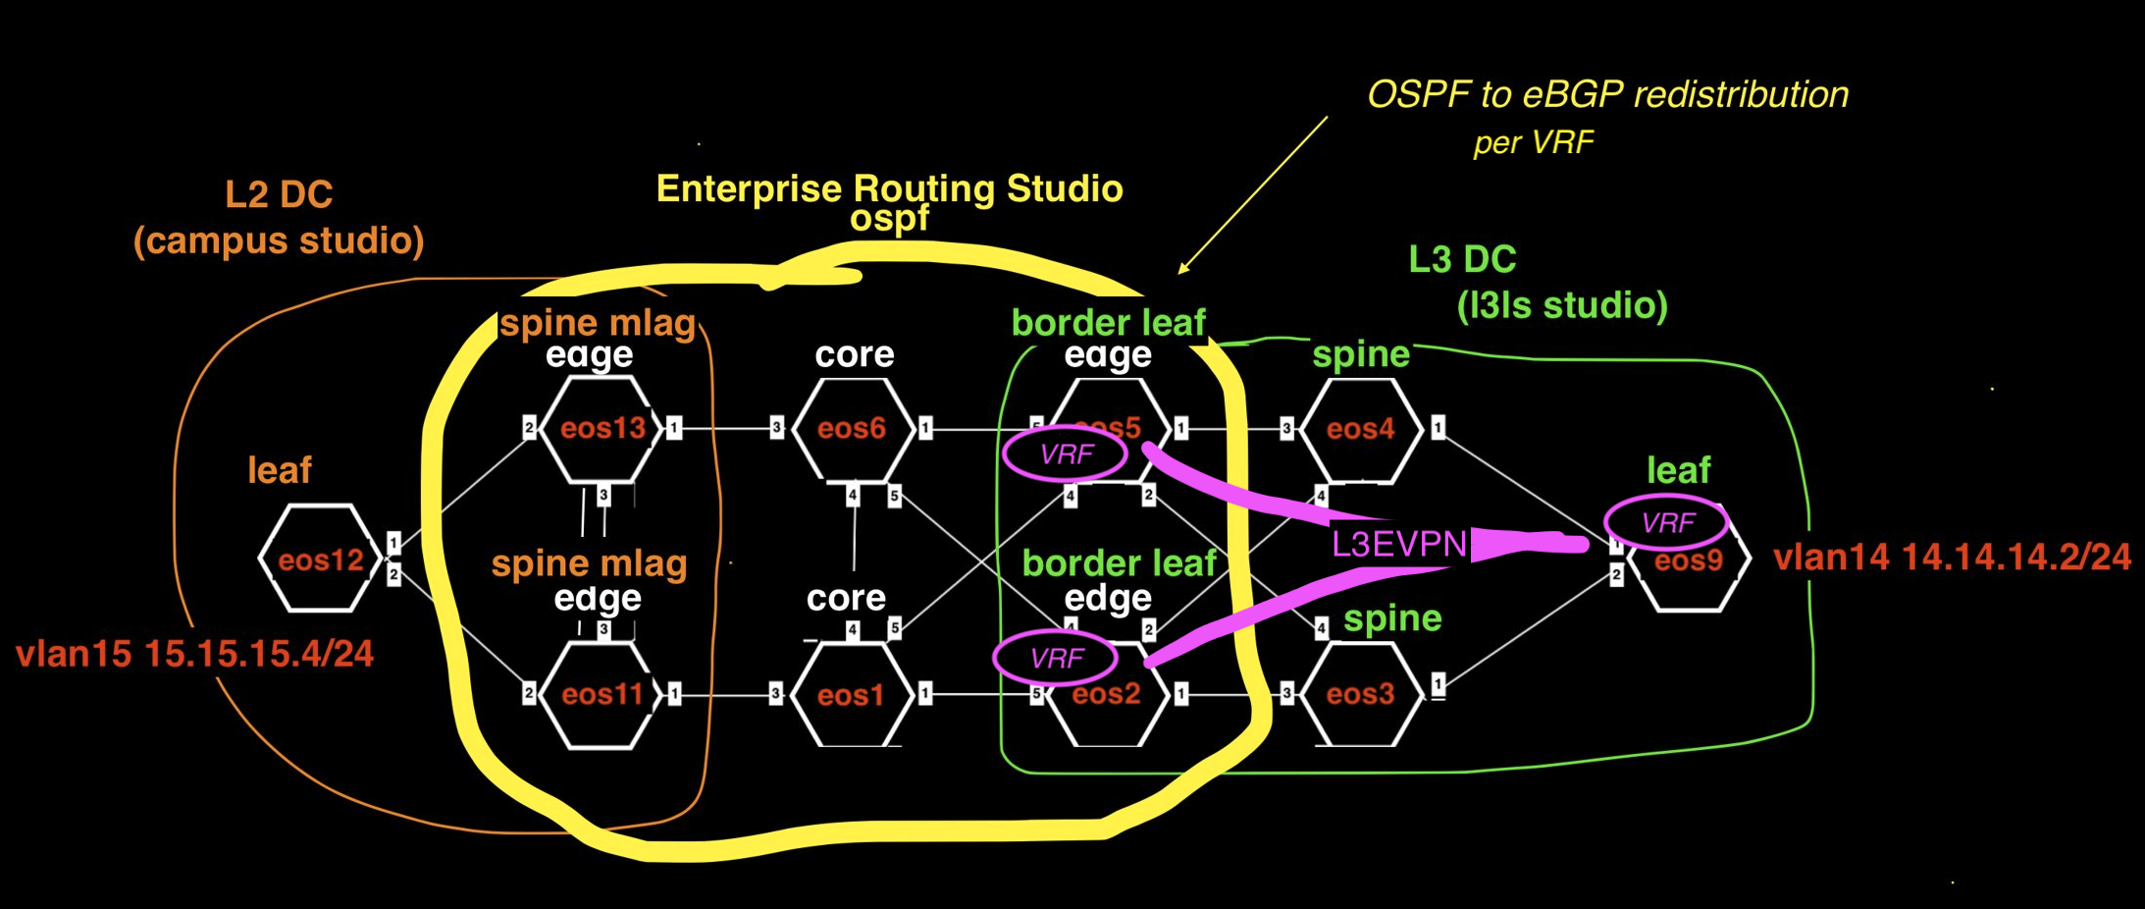
Example7:

Slide 52
Example 7 Tags
See tagsfile.txt to load tags through the API with tagman.py
Campus-Pod:L2DC-eos12 - EOS12
Campus:L2DC-eos11-eos12-eos13 - EOS11
Campus:L2DC-eos11-eos12-eos13 - EOS12
Campus:L2DC-eos11-eos12-eos13 - EOS13
Campus:L3DC-End-device-eos9 - EOS9
DC-Pod:1 - EOS2
DC-Pod:1 - EOS3
DC-Pod:1 - EOS4
DC-Pod:1 - EOS5
DC-Pod:1 - EOS9
DC:L3DC-eos2-eos3-eos4-eos5-eos9 - EOS2
DC:L3DC-eos2-eos3-eos4-eos5-eos9 - EOS3
DC:L3DC-eos2-eos3-eos4-eos5-eos9 - EOS4
DC:L3DC-eos2-eos3-eos4-eos5-eos9 - EOS5
DC:L3DC-eos2-eos3-eos4-eos5-eos9 - EOS9
Edge-Router-Domain:11-13 - EOS11
Edge-Router-Domain:11-13 - EOS13
Edge-Router-Domain:2 - EOS2
Edge-Router-Domain:5 - EOS5
Edge-Router-Domain:9 - EOS9
Leaf-Domain:2 - EOS2
Leaf-Domain:5 - EOS5
Leaf-Domain:9 - EOS9
Leaf-Number:1 - EOS2
Leaf-Number:2 - EOS5
Leaf-Number:3 - EOS9
Network:CoreNet-eos1-eos2-eos5-eos6-eos11-eos13 - EOS1
Network:CoreNet-eos1-eos2-eos5-eos6-eos11-eos13 - EOS11
Network:CoreNet-eos1-eos2-eos5-eos6-eos11-eos13 - EOS13
Network:CoreNet-eos1-eos2-eos5-eos6-eos11-eos13 - EOS2
Network:CoreNet-eos1-eos2-eos5-eos6-eos11-eos13 - EOS5
Network:CoreNet-eos1-eos2-eos5-eos6-eos11-eos13 - EOS6
Network:L3DC-End-device-eos9 - EOS9
Role:Core - EOS1
Role:Core - EOS6
Role:Edge-Router - EOS11
Role:Edge-Router - EOS13
Role:Edge-Router - EOS2
Role:Edge-Router - EOS5
Role:Leaf - EOS2
Role:Leaf - EOS5
Role:Leaf - EOS9
Role:Spine - EOS3
Role:Spine - EOS4
Spine-Number:1 - EOS4
Spine-Number:2 - EOS3
router_bgp.router_id:1.1.1.1 - EOS1
router_bgp.router_id:11.11.11.11 - EOS11
router_bgp.router_id:13.13.13.13 - EOS13
router_bgp.router_id:6.6.6.6 - EOS6

Slide 53
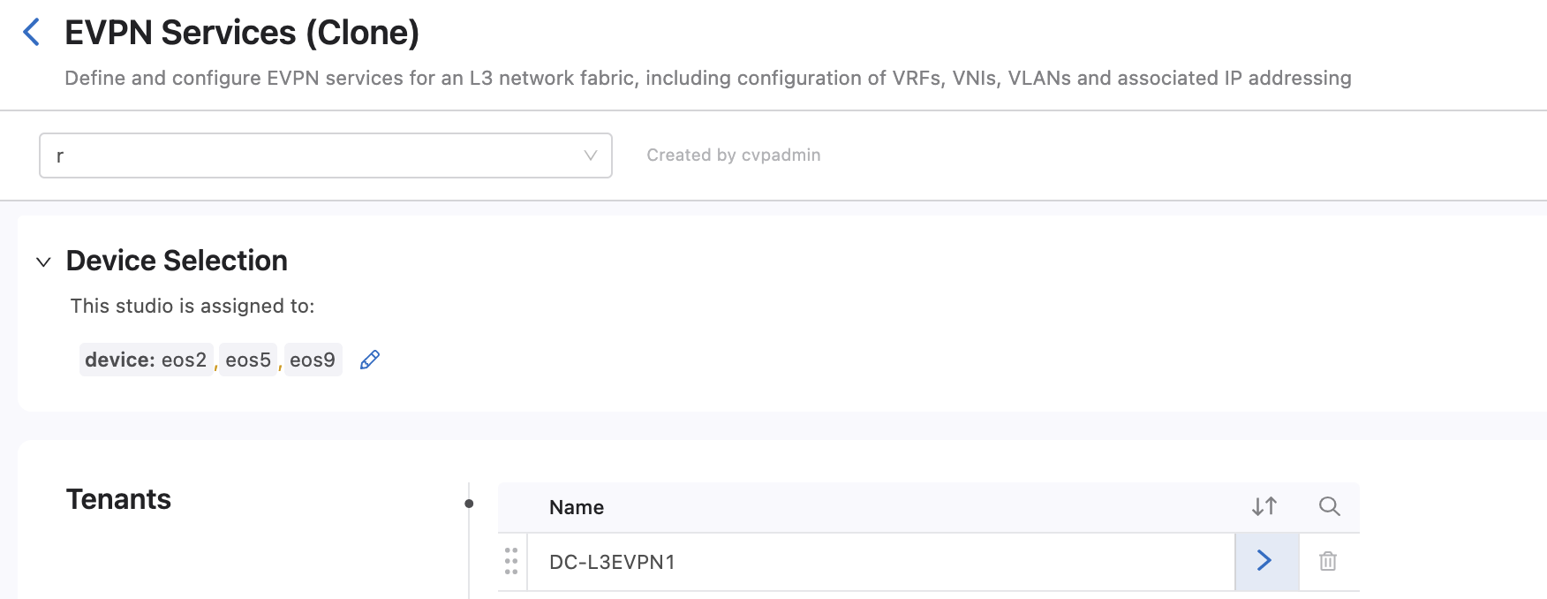
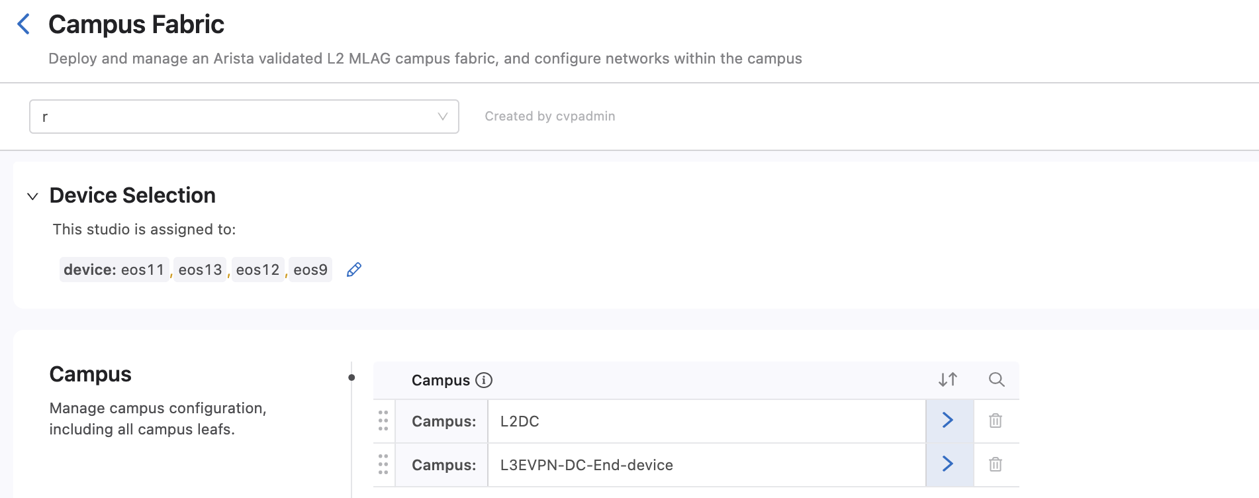
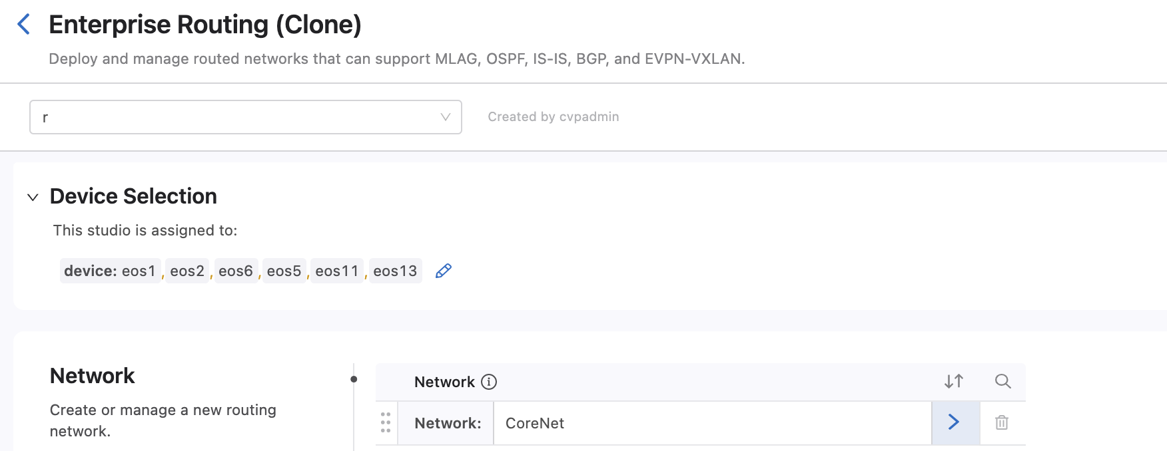
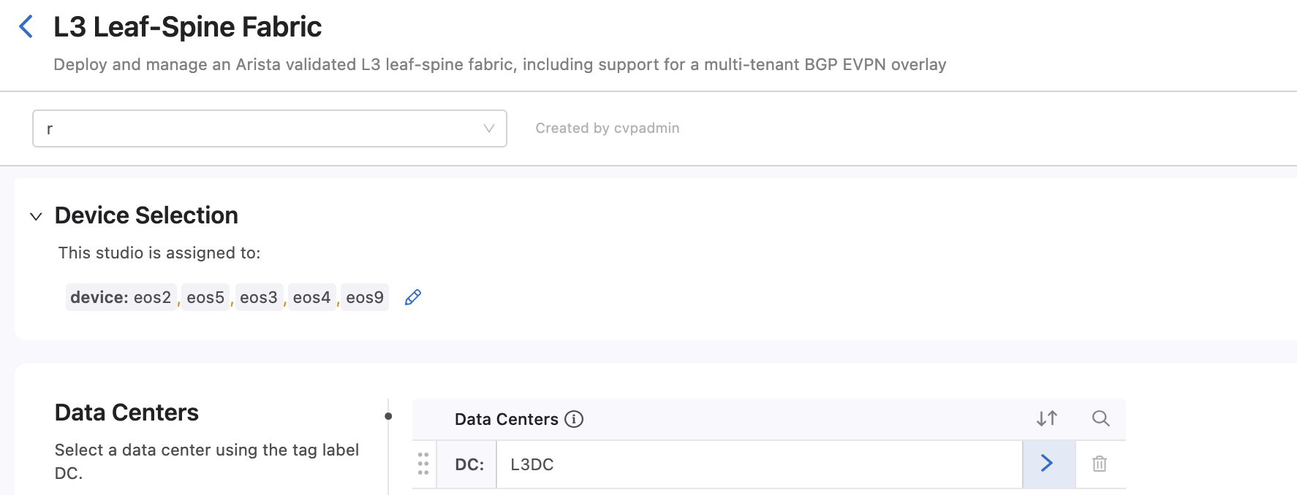
Device Selection

Slide 54
Test
From Campus switch eos12 ping DC Leaf eos9 14.14.14.2
From DC Leaf eos9 14.14.14.2 ping Campus switch eos12

Slide 55
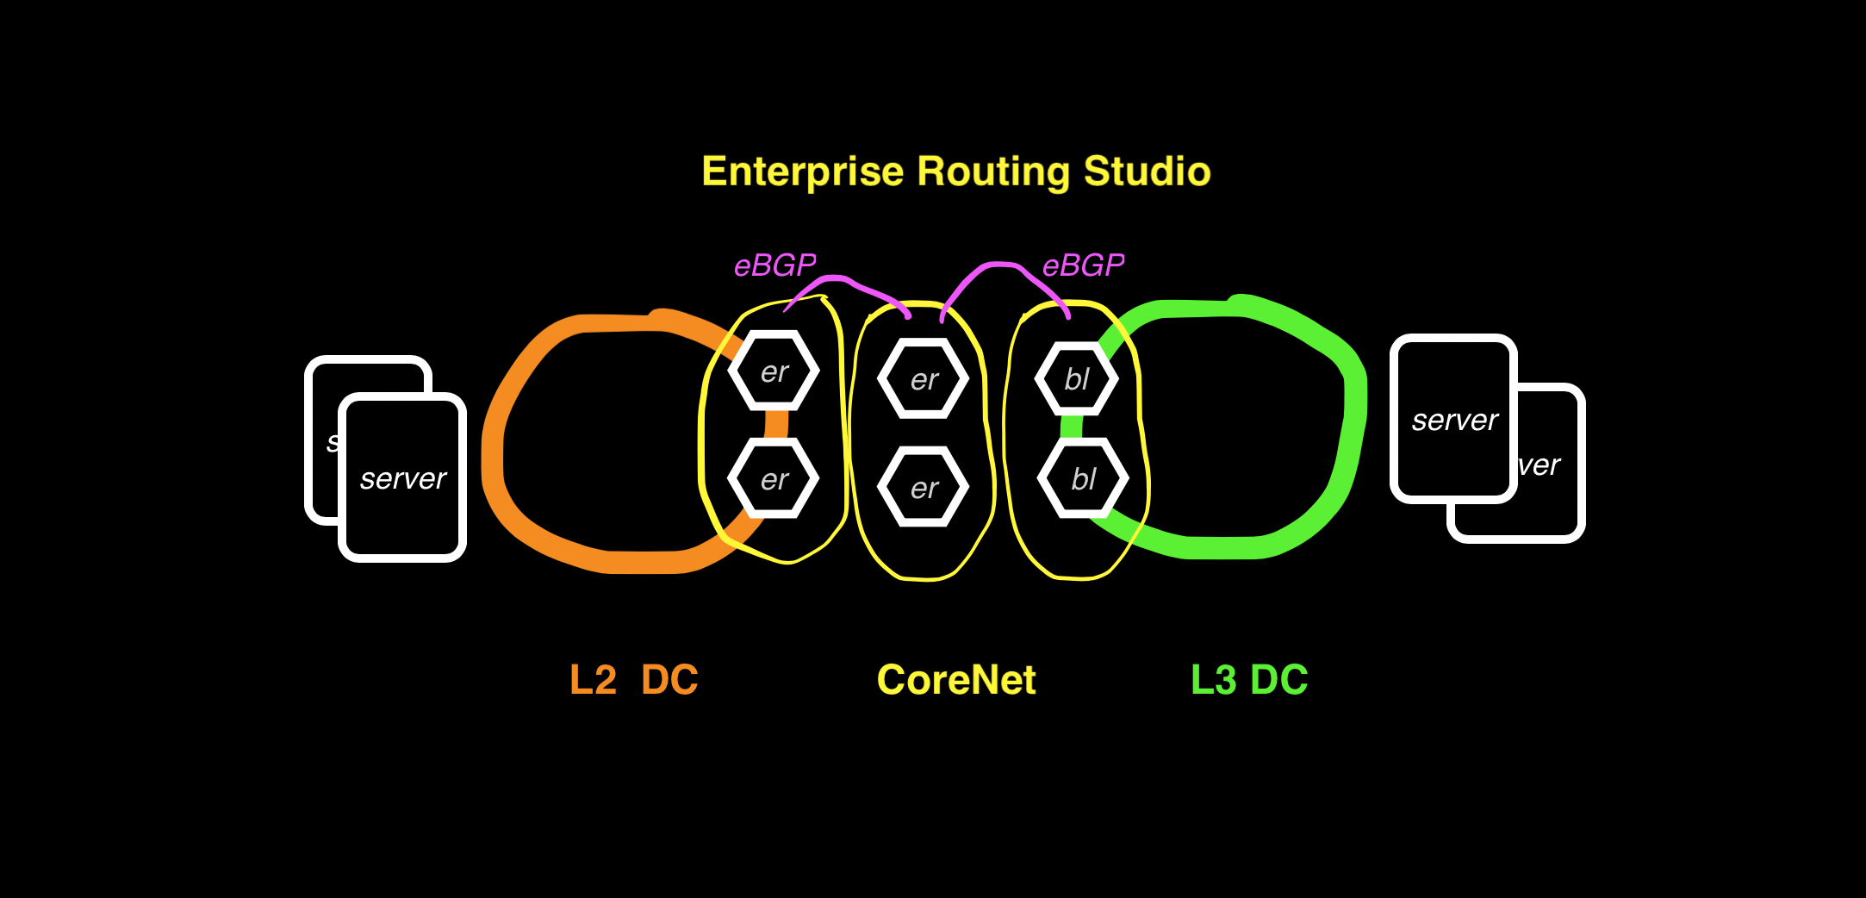
Example 8 BGP Routed Enterprise Network

Slide 56
Example8: BGP Routed Enterprise Network No OSPF is used in this example
In this example the Enterprise Routing Studio, consisting of 2 Edge Routers in a Camus, 2 Core Routers and 2 Edge Routers in L3DC

Slide 57

Example8:

Slide 58
Example 8 Tags
See tagsfile.txt to load tags through the API with tagman.py
Campus-Pod:12 - EOS12
Campus:L2DC-eos11-eos12-eos13 - EOS11
Campus:L2DC-eos11-eos12-eos13 - EOS12
Campus:L2DC-eos11-eos12-eos13 - EOS13
Campus:L3DC-End-device-eos9 - EOS9
DC-Pod:1 - EOS2
DC-Pod:1 - EOS3
DC-Pod:1 - EOS4
DC-Pod:1 - EOS5
DC-Pod:1 - EOS9
DC:L3DC-eos2-eos3-eos4-eos5-eos9 - EOS2
DC:L3DC-eos2-eos3-eos4-eos5-eos9 - EOS3
DC:L3DC-eos2-eos3-eos4-eos5-eos9 - EOS4
DC:L3DC-eos2-eos3-eos4-eos5-eos9 - EOS5
DC:L3DC-eos2-eos3-eos4-eos5-eos9 - EOS9
Edge-Router-Domain:11-13 - EOS11
Edge-Router-Domain:11-13 - EOS13
Edge-Router-Domain:2 - EOS2
Edge-Router-Domain:5 - EOS5
Edge-Router-Domain:9 - EOS9
Leaf-Domain:2 - EOS2
Leaf-Domain:5 - EOS5
Leaf-Domain:9 - EOS9
Leaf-Number:1 - EOS2
Leaf-Number:2 - EOS5
Leaf-Number:3 - EOS9
Network:CoreNet-eos1-eos6 - EOS1
Network:CoreNet-eos1-eos6 - EOS6
Network:L2DC-eos11-eos13 - EOS11
Network:L2DC-eos11-eos13 - EOS13
Network:L3DC-Border-Leafs-eos2-eos5 - EOS2
Network:L3DC-Border-Leafs-eos2-eos5 - EOS5
Network:L3DC-End-device-eos9 - EOS9
Role:Core - EOS1
Role:Core - EOS6
Role:Edge-Router - EOS11
Role:Edge-Router - EOS13
Role:Edge-Router - EOS2
Role:Edge-Router - EOS5
Role:Leaf - EOS2
Role:Leaf - EOS5
Role:Leaf - EOS9
Role:Spine - EOS3
Role:Spine - EOS4
Spine-Number:1 - EOS3
Spine-Number:2 - EOS4
router_bgp.router_id:1.1.1.1 - EOS1
router_bgp.router_id:11.11.11.11 - EOS11
router_bgp.router_id:13.13.13.13 - EOS13
router_bgp.router_id:6.6.6.6 - EOS6

Slide 59



Device Selection

Slide 60
Test
From Campus switch eos12 ping DC Leaf eos9 14.14.14.2
From DC Leaf eos9 14.14.14.2 ping Campus switch eos12

Slide 61

Example 9: VRF Lite

Slide 62
Example9: VRF Lite VRFs are used on the Enterprise Core and the DCs
In this example the Enterprise Routing Studio, consisting of 2 Edge Routers in a Camus, 2 Core Routers and 2 Edge Routers in L3DC

Slide 63

Example9:

Slide 64
Example 9 Tags
See tagsfile.txt to load tags through the API with tagman.py
Campus-Pod:L2DC-eos12 - EOS12
Campus:L2DC-eos11-eos12-eos13 - EOS11
Campus:L2DC-eos11-eos12-eos13 - EOS12
Campus:L2DC-eos11-eos12-eos13 - EOS13
Campus:L3DC-End-device-eos9 - EOS9
DC-Pod:1 - EOS2
DC-Pod:1 - EOS3
DC-Pod:1 - EOS4
DC-Pod:1 - EOS5
DC-Pod:1 - EOS9
DC:L3DC-eos2-eos3-eos4-eos5-eos9 - EOS2
DC:L3DC-eos2-eos3-eos4-eos5-eos9 - EOS3
DC:L3DC-eos2-eos3-eos4-eos5-eos9 - EOS4
DC:L3DC-eos2-eos3-eos4-eos5-eos9 - EOS5
DC:L3DC-eos2-eos3-eos4-eos5-eos9 - EOS9
Edge-Router-Domain:11-13 - EOS11
Edge-Router-Domain:11-13 - EOS13
Edge-Router-Domain:2 - EOS2
Edge-Router-Domain:5 - EOS5
Edge-Router-Domain:9 - EOS9
Leaf-Domain:2 - EOS2
Leaf-Domain:5 - EOS5
Leaf-Domain:9 - EOS9
Leaf-Number:1 - EOS2
Leaf-Number:2 - EOS5
Leaf-Number:3 - EOS9
Network:CoreNet-eos1-eos6 - EOS1
Network:CoreNet-eos1-eos6 - EOS6
Network:L2DC-eos11-eos13 - EOS11
Network:L2DC-eos11-eos13 - EOS13
Network:L3DC-Border-Leafs-eos2-eos5 - EOS2
Network:L3DC-Border-Leafs-eos2-eos5 - EOS5
Network:L3DC-End-device-eos9 - EOS9
Role:Core - EOS1
Role:Core - EOS6
Role:Edge-Router - EOS11
Role:Edge-Router - EOS13
Role:Edge-Router - EOS2
Role:Edge-Router - EOS5
Role:Leaf - EOS2
Role:Leaf - EOS5
Role:Leaf - EOS9
Role:Spine - EOS3
Role:Spine - EOS4
Spine-Number:1 - EOS3
Spine-Number:2 - EOS4
router_bgp.router_id:1.1.1.1 - EOS1
router_bgp.router_id:11.11.11.11 - EOS11
router_bgp.router_id:13.13.13.13 - EOS13
router_bgp.router_id:6.6.6.6 - EOS6

Slide 65

Device Selection

Slide 66
Test
From Campus switch eos12 ping DC Leaf eos9 14.14.14.2

Slide 67

Example 10: L3 Campus and EVPN VXLAN

Slide 68
Example10: L3 Campus and EVPN VXLAN EVPN is used to Stretch L2 and to segment different user groups
blah

Slide 69

Example10:

Slide 70


Slide 71
Example 9 Tags
See tagsfile.txt to load tags through the API with tagman.py
Role:Core - EOS10
Role:Core - EOS19
Role:Core - EOS2
Role:Core - EOS3
Role:Core - EOS4
Role:Core - EOS5
Role:Edge-Router - EOS1
Role:Edge-Router - EOS11
Role:Edge-Router - EOS12
Role:Edge-Router - EOS13
Role:Edge-Router - EOS14
Role:Edge-Router - EOS6
Role:Edge-Router - EOS7
Role:Edge-Router - EOS8
Role:Edge-Router - EOS9
Role:RR - EOS17
router_bgp.as:65001 - EOS14
router_bgp.as:65001 - EOS8
router_bgp.as:904 - EOS1
router_bgp.as:904 - EOS11
router_bgp.as:904 - EOS13
router_bgp.as:904 - EOS17
router_bgp.as:904 - EOS2
router_bgp.as:904 - EOS3
router_bgp.as:904 - EOS4
router_bgp.as:904 - EOS5
router_bgp.as:904 - EOS6
router_bgp.as:904 - EOS9
router_bgp.router_id:1.1.1.1 - EOS1
router_bgp.router_id:10.10.10.10 - EOS10
router_bgp.router_id:11.11.11.11 - EOS11
router_bgp.router_id:13.13.13.13 - EOS13
router_bgp.router_id:14.14.14.14 - EOS14
router_bgp.router_id:17.17.17.17 - EOS17
router_bgp.router_id:19.19.19.19 - EOS19
router_bgp.router_id:2.2.2.2 - EOS2
router_bgp.router_id:3.3.3.3 - EOS3
router_bgp.router_id:4.4.4.4 - EOS4
router_bgp.router_id:5.5.5.5 - EOS5
router_bgp.router_id:6.6.6.6 - EOS6
router_bgp.router_id:7.7.7.7 - EOS7
router_bgp.router_id:8.8.8.8 - EOS8
router_bgp.router_id:9.9.9.9 - EOS9
Campus:Site1-Floor1-eos11 - EOS11
Campus:Site1-Floor2-eos13 - EOS13
Campus:Site2-Floor1-eos9 - EOS9
Edge-Router-Domain:End-Device-eos12 - EOS12
Edge-Router-Domain:External-FW-eos8 - EOS8
Edge-Router-Domain:FW-Border-Router - EOS6
Edge-Router-Domain:ISP - EOS7
Edge-Router-Domain:ISP-Border-Router - EOS1
Edge-Router-Domain:Internal-FW-eos14 - EOS14
Edge-Router-Domain:Site1 - EOS11
Edge-Router-Domain:Site1 - EOS13
Edge-Router-Domain:Site2 - EOS9
Network:CoreNet-eos1-eos2-eos3-eos4-eos5-eos6-eos9-eos11-eos13-eos17 - EOS1
Network:CoreNet-eos1-eos2-eos3-eos4-eos5-eos6-eos9-eos11-eos13-eos17 - EOS11
Network:CoreNet-eos1-eos2-eos3-eos4-eos5-eos6-eos9-eos11-eos13-eos17 - EOS13
Network:CoreNet-eos1-eos2-eos3-eos4-eos5-eos6-eos9-eos11-eos13-eos17 - EOS17
Network:CoreNet-eos1-eos2-eos3-eos4-eos5-eos6-eos9-eos11-eos13-eos17 - EOS2
Network:CoreNet-eos1-eos2-eos3-eos4-eos5-eos6-eos9-eos11-eos13-eos17 - EOS3
Network:CoreNet-eos1-eos2-eos3-eos4-eos5-eos6-eos9-eos11-eos13-eos17 - EOS4
Network:CoreNet-eos1-eos2-eos3-eos4-eos5-eos6-eos9-eos11-eos13-eos17 - EOS5
Network:CoreNet-eos1-eos2-eos3-eos4-eos5-eos6-eos9-eos11-eos13-eos17 - EOS6
Network:CoreNet-eos1-eos2-eos3-eos4-eos5-eos6-eos9-eos11-eos13-eos17 - EOS9
Network:End-Device-eos12 - EOS12
Network:FireWalls - EOS14
Network:FireWalls - EOS8
Network:ISP - EOS10
Network:ISP - EOS19
Network:ISP - EOS7

Slide 72




Device Selection

Slide 73
Test
From inside GREEN VRF in eos9, eos 11 and 13 ping to ISP 10.10.10.10 and other destinations in GREEN
From inside RED VRF in eos9 and eos13 ping to BLUE end device 1.2.3.12 and other destinations in RED
From inside BLACK VRF on eos11 ping to BLACK 4.3.1.9

